Slide 1
Object-Oriented and
Classical Software Engineering
8th Edition, WCB/McGraw-Hill, 2010
Stephen R. Schach srs@vuse.vanderbilt.edu

Slide 2
CHAPTER 12
OBJECT-ORIENTED ANALYSIS

Slide 3
Overview
The analysis workflow
Extracting the entity classes
Object-oriented analysis: The elevator problem case study
Functional modeling: The elevator problem case study
Entity class modeling: The elevator problem case study
Dynamic modeling: The elevator problem case study
The test workflow: Object-oriented analysis

Slide 4
Overview (contd)
Extracting the boundary and control classes
The initial functional model: The MSG Foundation case study
The initial class diagram: The MSG Foundation case study
The initial dynamic model: The MSG Foundation case study
Extracting the boundary classes: The MSG Foundation case study
Extracting the boundary classes: The MSG Foundation case study

Slide 5
Overview (contd)
Refining the use cases: The MSG Foundation case study
Use-case realization: The MSG Foundation case study
Incrementing the class diagram: The MSG Foundation case study
The specification document in the Unified Process
More on actors and use cases
CASE tools for the object-oriented analysis workflow
Challenges of the object-oriented analysis workflow

Slide 6
Object-Oriented Analysis
OOA is a semiformal analysis technique for the object-oriented paradigm
  There are over 60 equivalent techniques
  Today, the Unified Process is the only viable alternative
During this workflow
  The classes are extracted
Remark
  The Unified Process assumes knowledge of class extraction

Slide 7
12.1 The Analysis Workflow
The analysis workflow has two aims
  Obtain a deeper understanding of the requirements
  Describe them in a way that will result in a maintainable design and implementation

Slide 8
The Analysis Workflow (contd)
There are three types of classes:
Entity classes
Boundary classes
Control classes

Slide 9
The Analysis Workflow (contd)
Entity class
  Models long-lived information
Examples:
  Account Class
  Investment Class

Slide 10
The Analysis Workflow (contd)
Boundary class
  Models the interaction between the product and the environment
  A boundary class is generally associated with input or output
Examples:
  Investments Report Class
  Mortgages Report Class

Slide 11
The Analysis Workflow (contd)
Control class
  Models complex computations and algorithms
Example:
  Estimate Funds for Week Class

Slide 12

UML Notation for These Three Class Types
Stereotypes (extensions of UML)
Figure 12.1

Slide 13
12.2 Extracting the Entity Classes
Perform the following three steps incrementally and iteratively
  Functional modeling
    Present scenarios of all the use cases (a scenario is an instance of a use case)
  Class modeling
    Determine the entity classes and their attributes
    Determine the interrelationships and interactions between the entity classes
    Present this information in the form of a class diagram
  Dynamic modeling
    Determine the operations performed by or to each entity class
    Present this information in the form of a statechart

Slide 14
12.3 Object-Oriented Analysis: The Elevator Problem Case Study
A product is to be installed to control n elevators in a building with m floors. The problem concerns the logic required to move elevators between floors according to the following constraints:
1. Each elevator has a set of m buttons, one for each floor. These illuminate when pressed and cause the elevator to visit the corresponding floor. The illumination is canceled when the corresponding floor is visited by the elevator
2. Each floor, except the first and the top floor, has two buttons, one to request an up-elevator, one to request a down-elevator. These buttons illuminate when pressed. The illumination is canceled when an elevator visits the floor, then moves in the desired direction
3. If an elevator has no requests, it remains at its current floor with its doors closed

Slide 15
12.4 Functional Modeling: The Elevator Problem Case Study
A use case describes the interaction between
  The product, and
  The actors (external users)

Slide 16
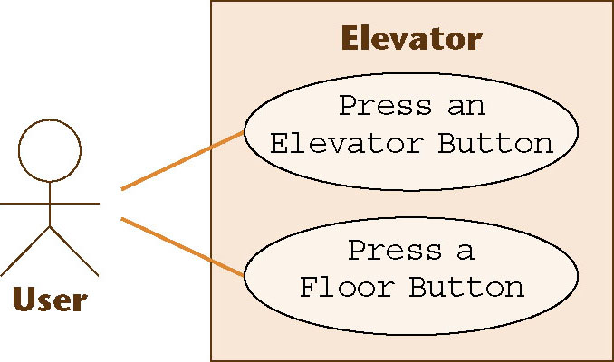
Use Cases
For the elevator problem, there are only two possible use cases
  Press an Elevator Button, and
  Press a Floor Button
Figure 12.2

Slide 17
Scenarios
A use case provides a generic description of the overall functionality
A scenario is an instance of a use case
Sufficient scenarios need to be studied to get a comprehensive insight into the target product being modeled

Slide 18
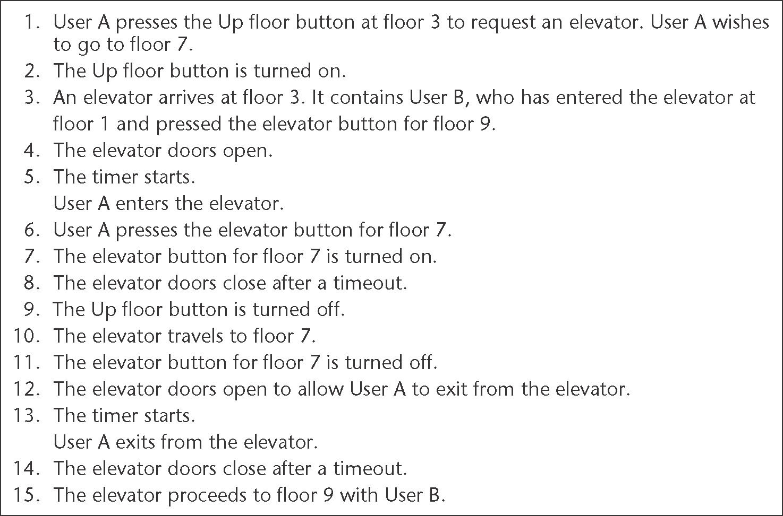
Normal Scenario: Elevator Problem
Figure 12.3

Slide 19

Exception Scenario: Elevator Problem
Figure 12.4

Slide 20
12.5 Entity Class Modeling : The Elevator Problem Case Study
Extract classes and their attributes
  Represent them using a UML diagram
One alternative: Deduce the classes from use cases and their scenarios
  Possible danger: Often there are many scenarios, and hence
  Too many candidate classes
Other alternatives:
  CRC cards (if you have domain knowledge)
  Noun extraction

Slide 21
12.5.1 Noun Extraction
A two-stage process
Stage 1. Concise problem definition
  Describe the software product in single paragraph
  Buttons in elevators and on the floors control the movement of n elevators in a building with m floors. Buttons illuminate when pressed to request the elevator to stop at a specific floor; the illumination is canceled when the request has been satisfied. When an elevator has no requests, it remains at its current floor with its doors closed

Slide 22
Noun Extraction (contd)
Stage 2. Identify the nouns
  Identify the nouns in the informal strategy
  Buttons in elevators and on the floors control the movement of n elevators in a building with m floors. Buttons illuminate when pressed to request the elevator to stop at a specific floor; the illumination is canceled when the request has been satisfied. When an elevator has no requests, it remains at its current floor with its doors closed
Use the nouns as candidate classes

Slide 23
Noun Extraction (contd)
Nouns
  button, elevator, floor, movement, building, illumination, request, door
  floor, building, door are outside the problem boundary — exclude
  movement, illumination, request are abstract nouns — exclude (they may become attributes)
Candidate classes:
  Elevator Class and Button Class
Subclasses:
  Elevator Button Class and Floor Button Class

Slide 24
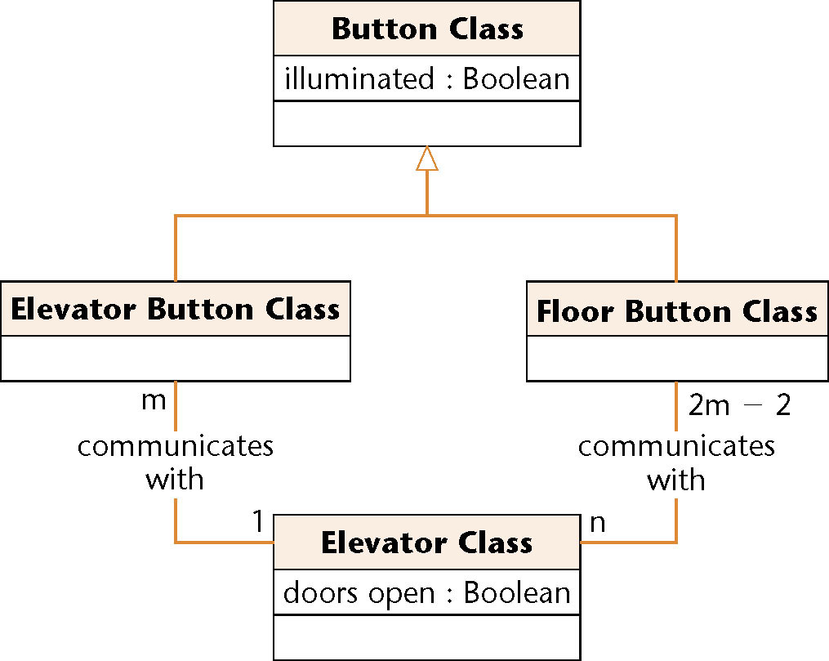
First Iteration of Class Diagram
Figure 12.5
Problem
  Buttons do not communicate directly with elevators
  We need an additional class: Elevator Controller Class

Slide 25
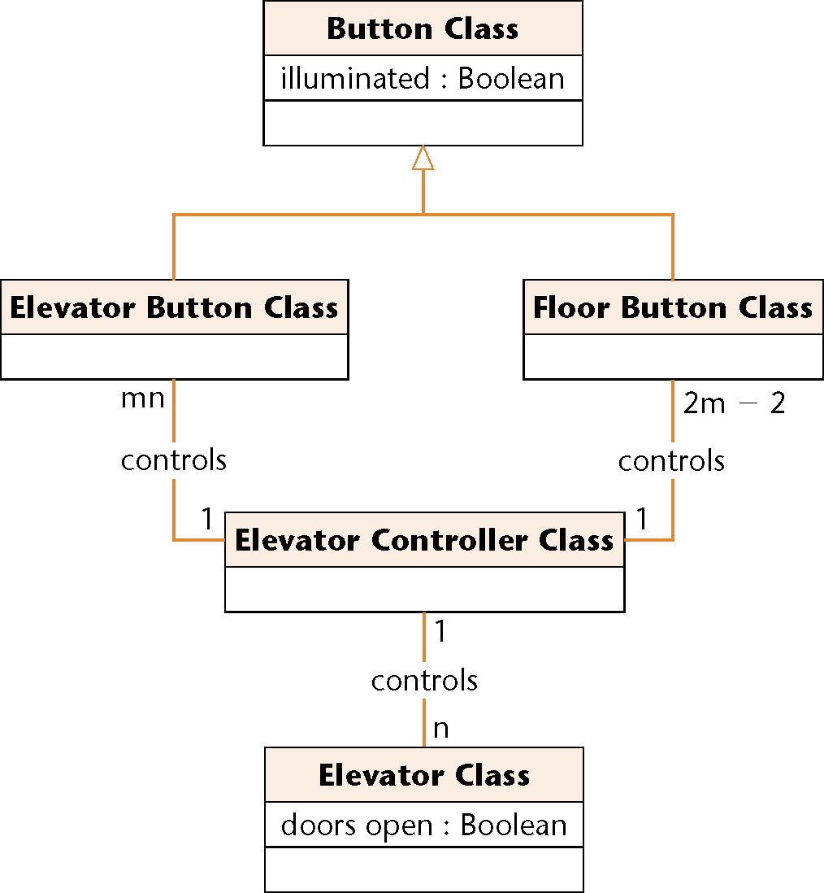
Second Iteration of Class Diagram
All relationships are now 1-to-n
  This makes design and implementation easier
Figure 12.6

Slide 26
12.5.2 CRC Cards
Used since 1989 for OOA
For each class, fill in a card showing
  Name of Class
  Functionality (Responsibility)
  List of classes it invokes (Collaboration)
Now CRC cards are automated (CASE tool component)

Slide 27
CRC Cards (contd)
Strength
  When acted out by team members, CRC cards are a powerful tool for highlighting missing or incorrect items
Weakness
  If CRC cards are used to identify entity classes, domain expertise is needed

Slide 28
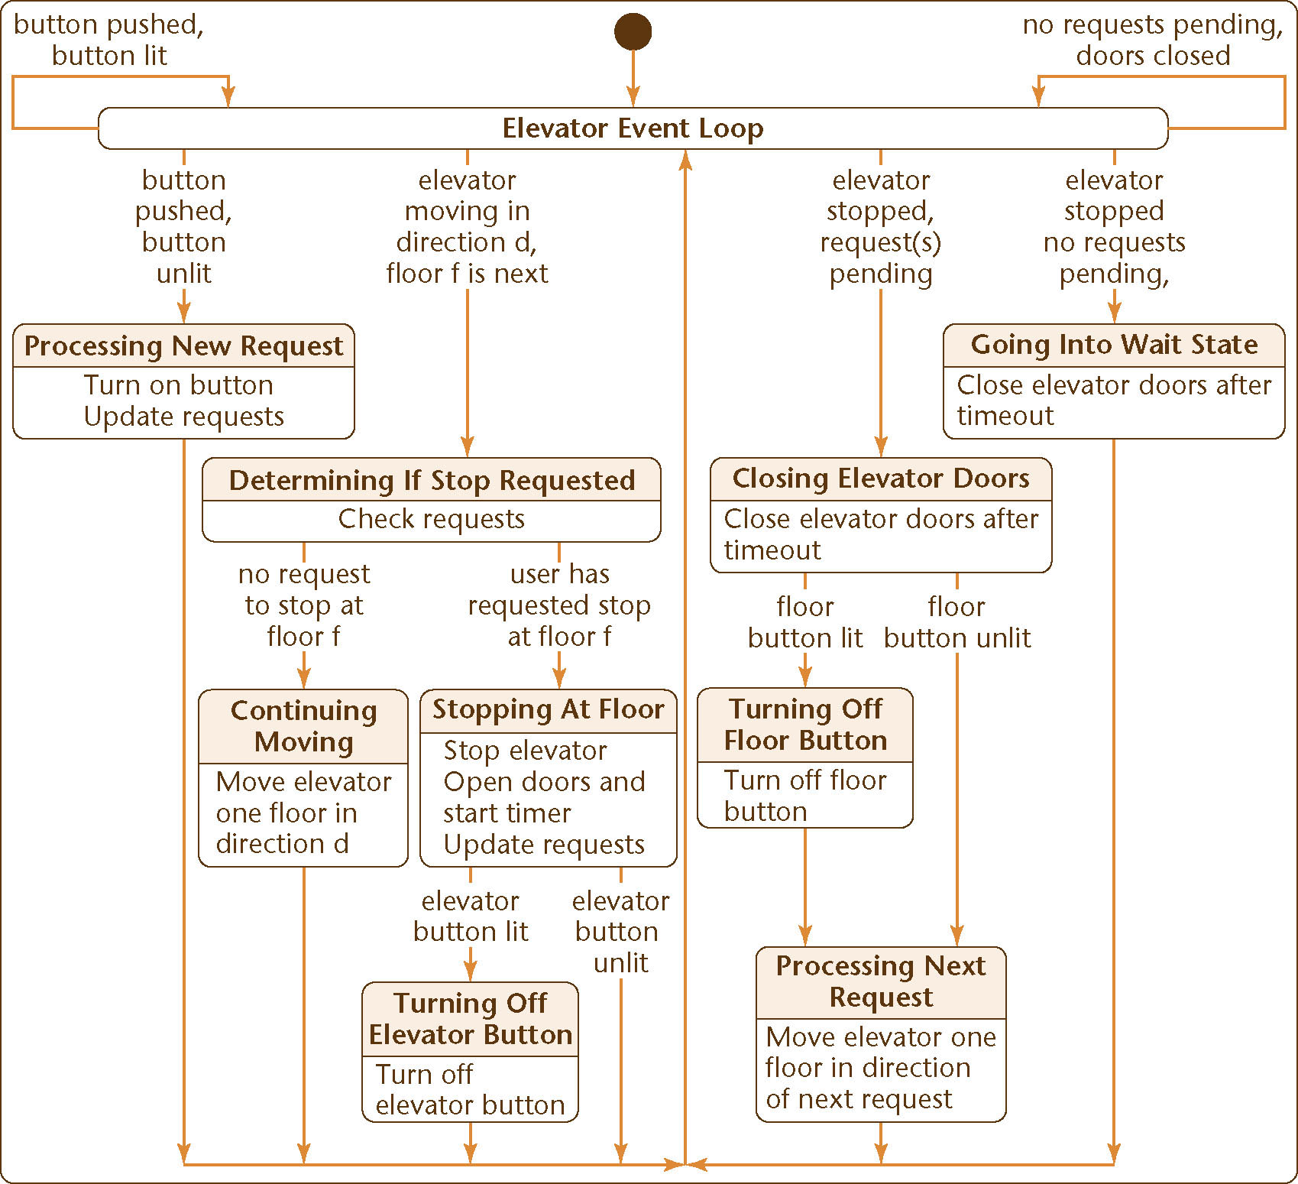
12.6 Dynamic Modeling: The Elevator Problem Case Study
Produce a UML statechart
State, event, and predicate are distributed over the statechart
Figure 12.7

Slide 29
Dynamic Modeling: Elevator Problem (contd)
This UML statechart is equivalent to the state transition diagram of Figures 11.15 through 11.17
This is shown by considering specific scenarios
In fact, a statechart is constructed by modeling the events of the scenarios

Slide 30
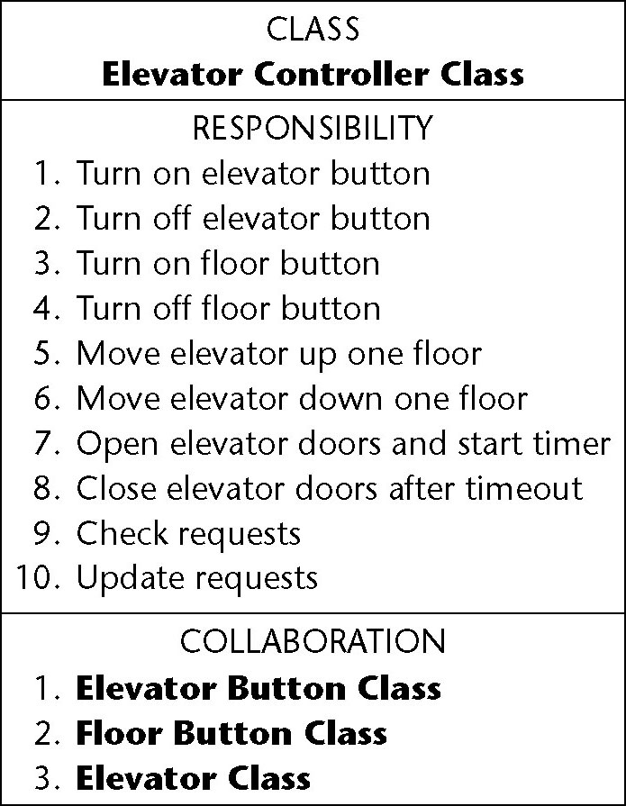
12.7 The Test Workflow: Object-Oriented Analysis
CRC cards are an excellent testing technique
Figure 12.8

Slide 31
CRC Cards
Consider responsibility
  1. Turn on elevator button
This is totally inappropriate for the object-oriented paradigm
  Responsibility-driven design has been ignored
  Information hiding has been ignored
Responsibility
  1. Turn on elevator button
should be
  1. Send message to Elevator Button Class to turn itself on

Slide 32
CRC Cards (contd)
Also, a class has been overlooked
The elevator doors have a state that changes during execution (class characteristic)
  Add class Elevator Doors Class
  Safety considerations
Modify the CRC card

Slide 33
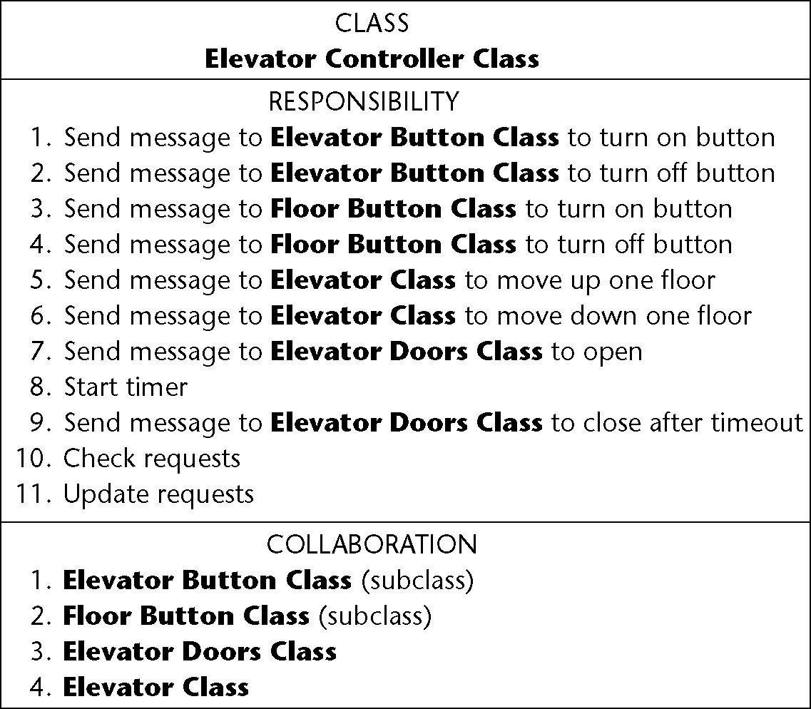
Second Iteration of the CRC Card
Figure 12.9

Slide 34
CRC Cards (contd)
Having modified the class diagram, reconsider the
  Use-case diagram (no change)
  Class diagram (see the next slide)
  Statecharts
  Scenarios (see the slide after the next slide)

Slide 35
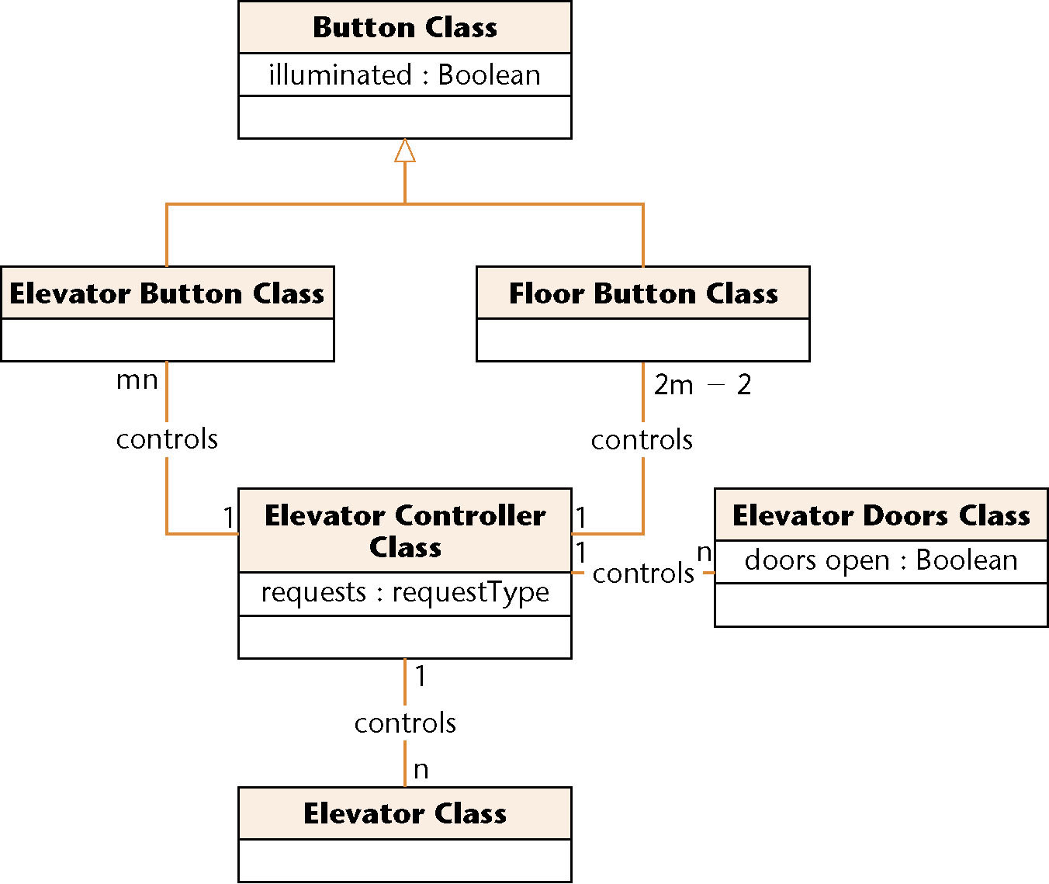
Third Iteration of Class Diagram
Figure 12.10

Slide 36
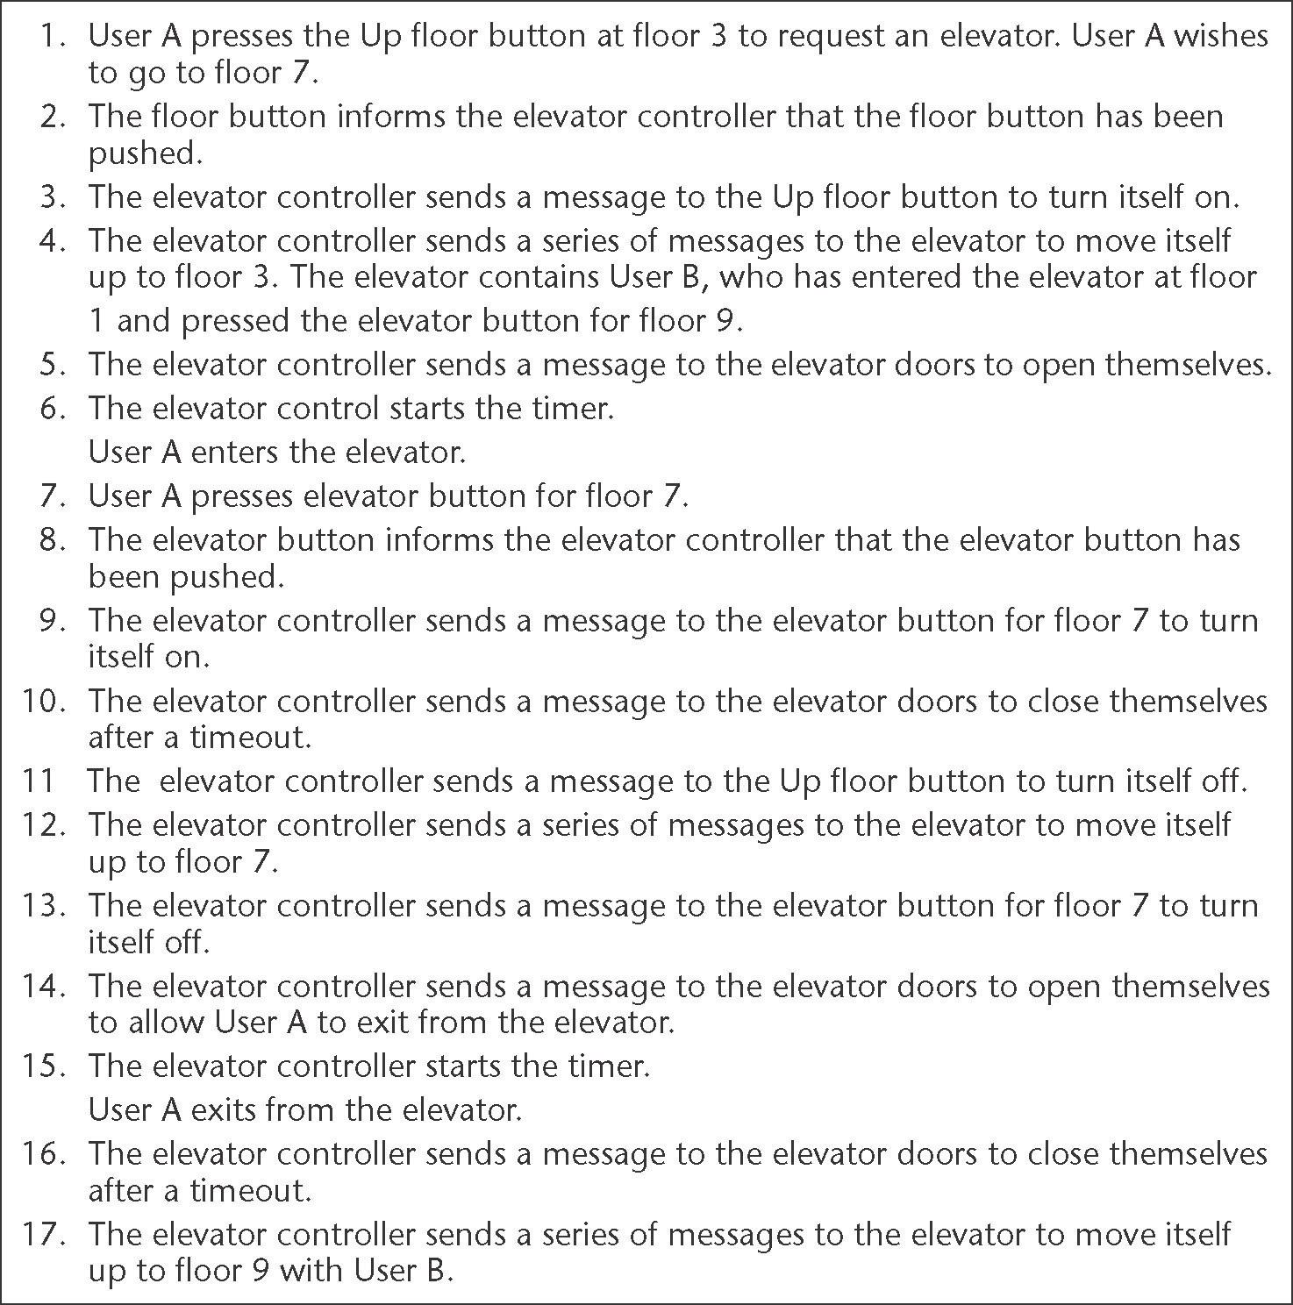
Second Iteration of the Normal Scenario:
Figure 12.11

Slide 37
OOA: Elevator Problem (contd)
The object-oriented analysis is now fine
We should rather say:
  The object-oriented analysis is fine for now
We may need to return to the object-oriented analysis workflow during the object-oriented design workflow

Slide 38
12.8 Extracting the Boundary and Control Classes
Each
  Input screen,
  Output screen, and
  Report
is modeled by its own boundary class
Each nontrivial computation is modeled by a control class

Slide 39
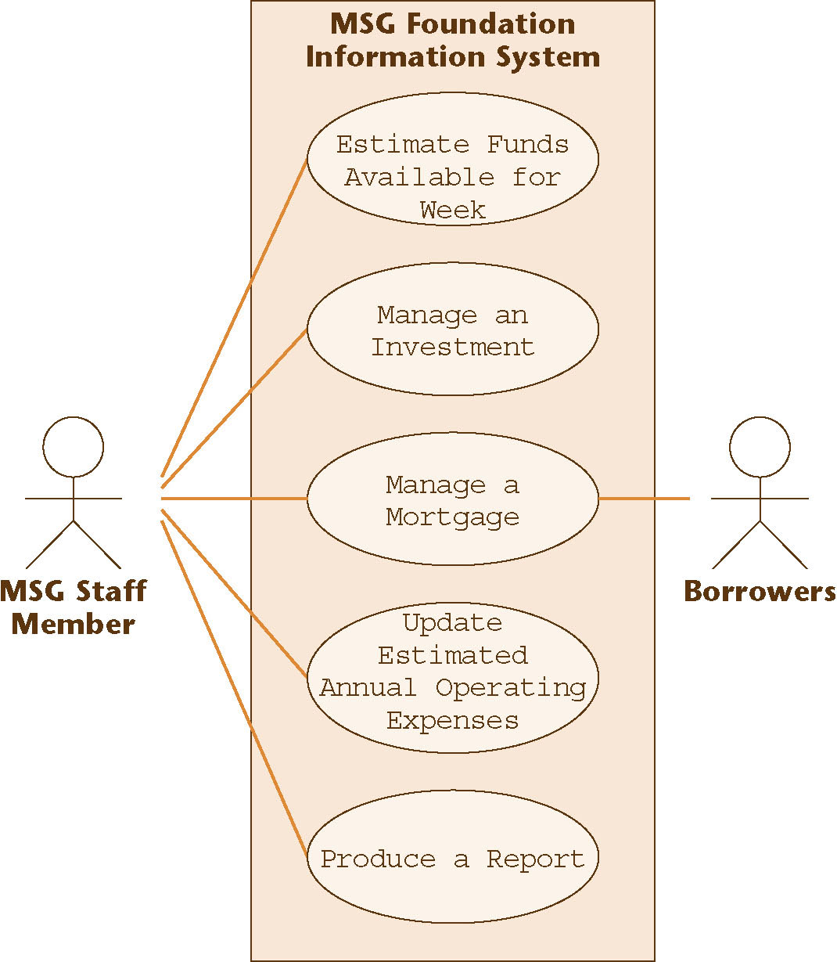
12.9 The Initial Functional Model: MSG Foundation
Recall the seventh iteration of the use-case diagram
Figure 12.12

Slide 40
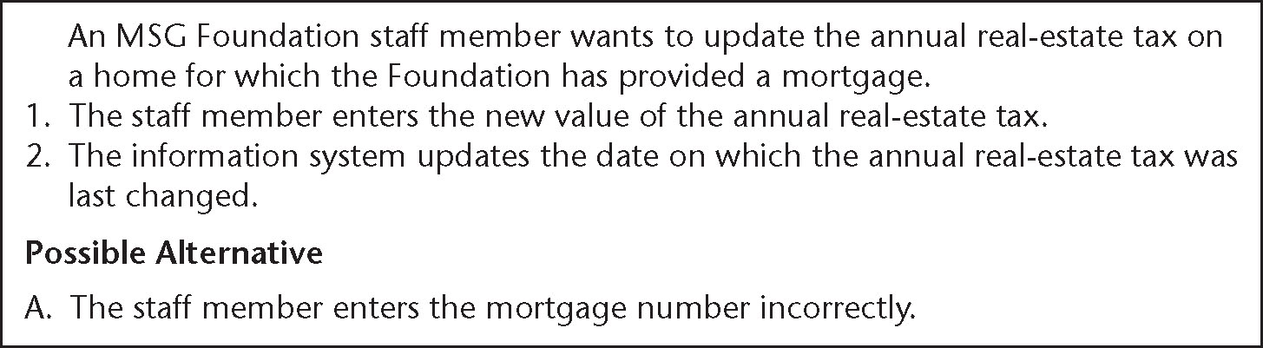
Use Case Manage a Mortgage
One possible extended scenario
Figure 12.13

Slide 41
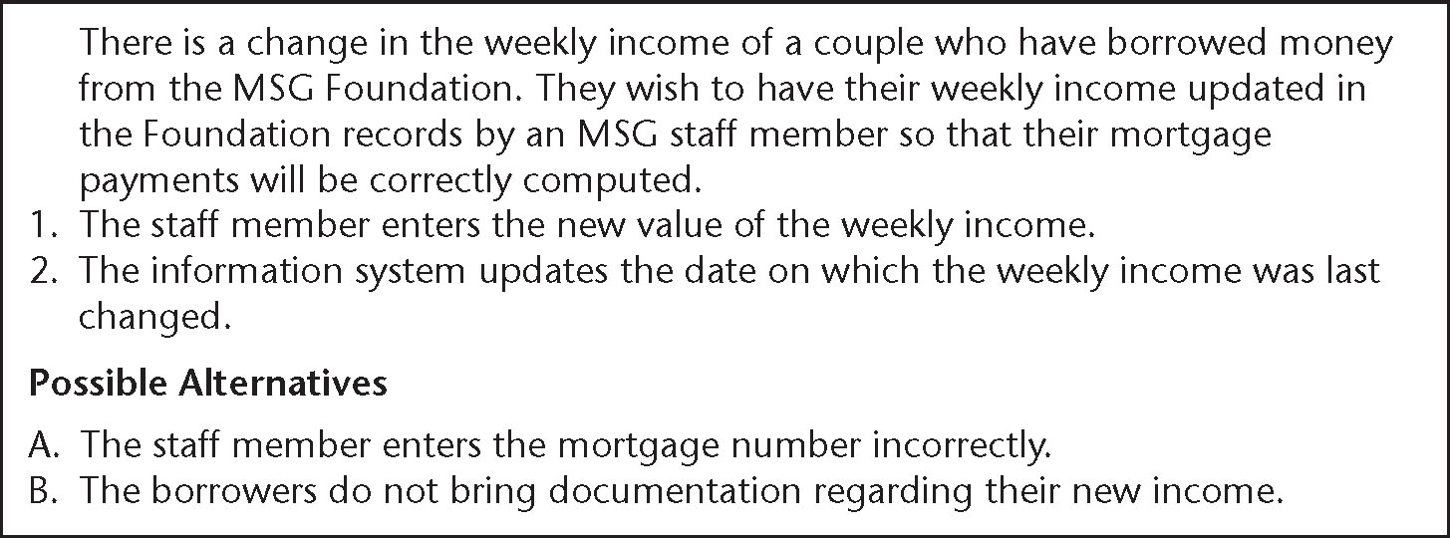
Use Case Manage a Mortgage (contd)
A second extended scenario
Figure 12.14

Slide 42
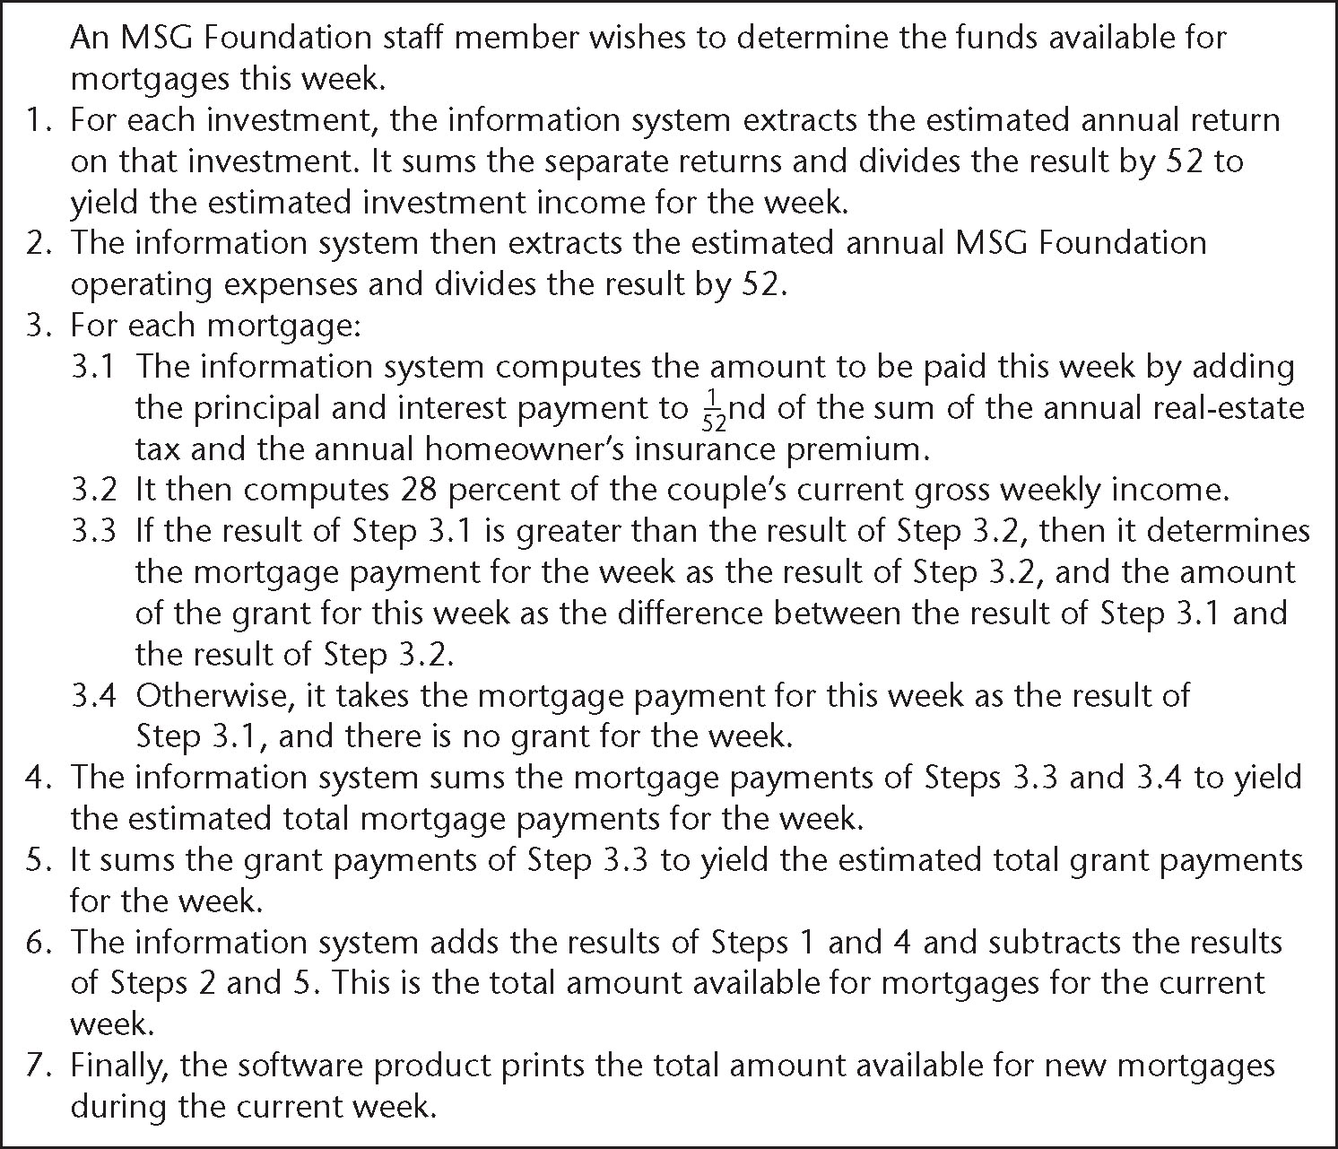
Use Case Estimate Funds Available for Week
One possible scenario
Figure 12.15

Slide 43
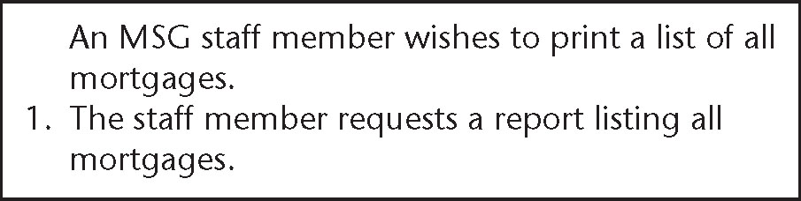
Use Case Produce a Report
One possible scenario
Figure 12.16

Slide 44
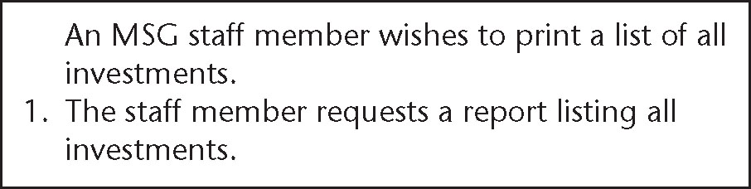
Use Case Produce a Report (contd)
Another possible scenario
Figure 12.17

Slide 45
12.10 The Initial Class Diagram: MSG Foundation
The aim of entity modeling step is to extract the entity classes, determine their interrelationships, and find their attributes
Usually, the best way to begin this step is to use the two-stage noun extraction method

Slide 46
Noun Extraction: MSG Foundation
Stage 1: Describe the information system in a single paragraph
  Weekly reports are to be printed showing how much money is available for mortgages. In addition, lists of investments and mortgages must be printed on demand.

Slide 47
Noun Extraction: MSG Foundation (contd)
Stage 2: Identify the nouns in this paragraph
  Weekly reports are to be printed showing how much money is available for mortgages. In addition, lists of investments and mortgages must be printed on demand.
The nouns are report, money, mortgage, list, and investment

Slide 48
Noun Extraction: MSG Foundation (contd)
Nouns report and list are not long lived, so they are unlikely to be entity classes (report will surely turn out to be a boundary class)
money is an abstract noun
This leaves two candidate entity classes
  Mortgage Class and Investment Class

Slide 49
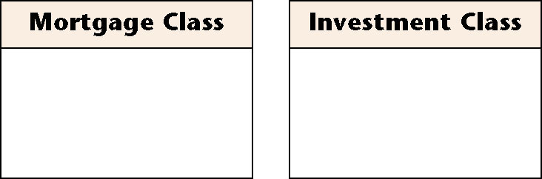
First Iteration of the Initial Class Diagram
Figure 12.18

Slide 50
Second Iteration of the Initial Class Diagram
Operations performed on the two entity classes are likely to be very similar
  Insertions, deletions, and modifications
  All members of both entity classes have to be printed on demand
Mortgage Class and Investment Class should be subclasses of a superclass called Asset Class

Slide 51
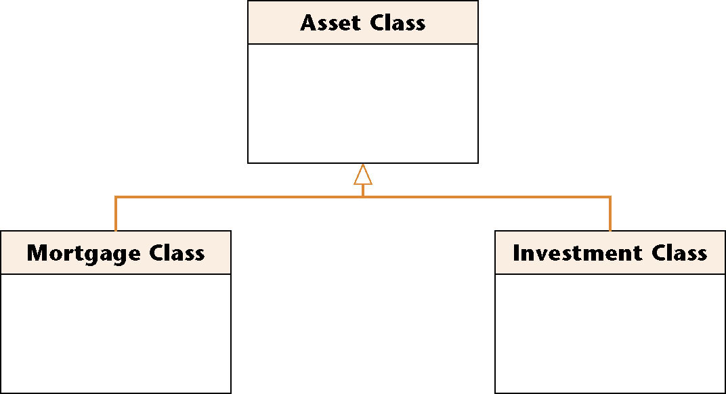
Second Iteration of Initial Class Diagram (contd)
Figure 12.19

Slide 52
Back to the Requirements Workflow
The current five use cases include Manage a Mortgage and Manage an Investment
These two can now be combined into a single use case, Manage an Asset

Slide 53
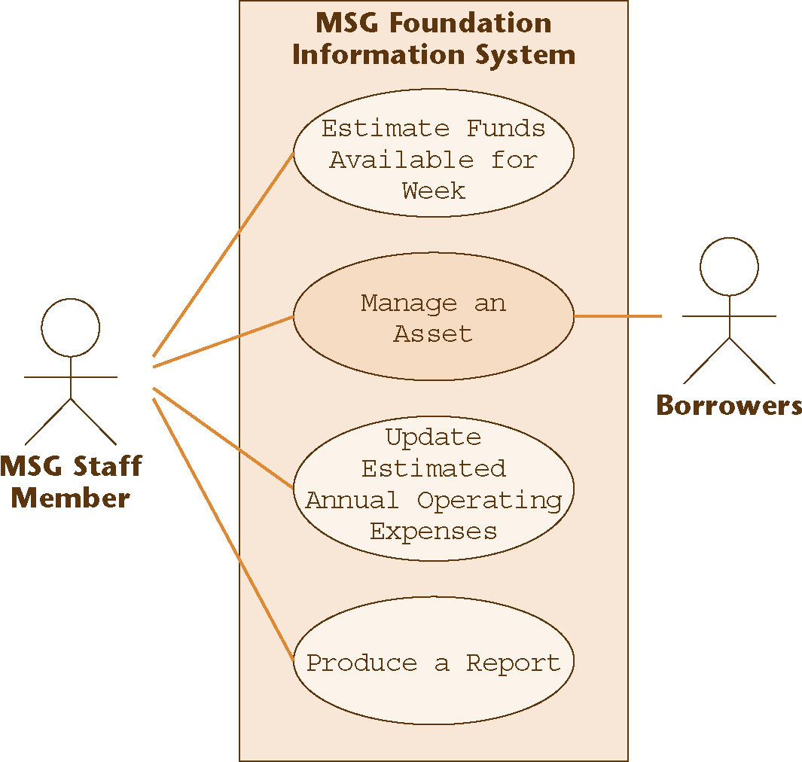
Eighth Iteration of the Use-Case Diagram
The new use case is shaded
Figure 12.20

Slide 54
Initial Class Diagram: MSG Foundation (contd)
Finally, we add the attributes of each class to the class diagram
  For the MSG Foundation case study, the result is shown on the next slide
The empty rectangle at the bottom of each box will later be filled with the operations of that class

Slide 55
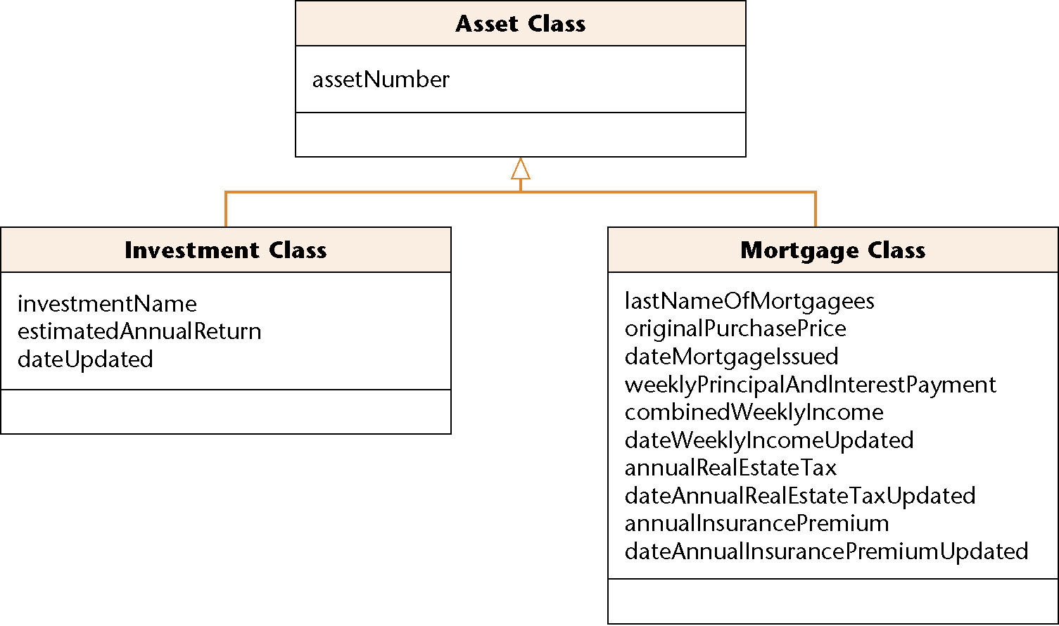
Second Iteration of Initial Class Diagram (contd)
Figure 12.21

Slide 56
Iteration and Incrementation
The phrase “iterate and increment” also includes the possibility of having to decrement what has been developed to date
  A mistake may have been made, and backtracking is needed
  As a consequence of reorganizing the UML models, one or more artifacts may have become superfluous

Slide 57
12.11 The Initial Dynamic Model: MSG Foundation
Dynamic modeling is the third step in extracting the entity classes
A statechart is constructed that reflects all the operations performed by or to the software product
The operations are determined from the scenarios

Slide 58
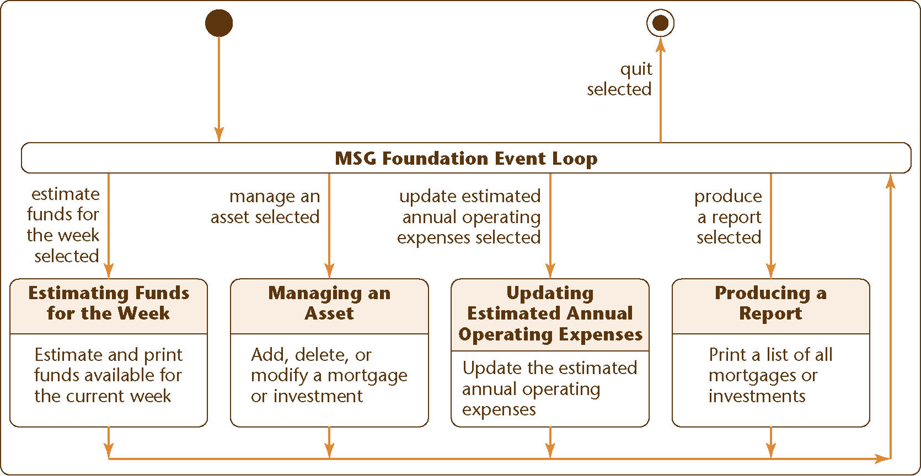
Initial Dynamic Model: MSG Foundation (contd)
Figure 12.22

Slide 59
Initial Dynamic Model: MSG Foundation (contd)
The statechart reflects the operations of the complete MSG Foundation information system
  The solid circle on the top left represents the initial state, the starting point of the statechart
  The white circle containing the small black circle on the top right represents the final state
  States other than the initial and final states are represented by rectangles with rounded corners
  The arrows represent possible transitions from state to state

Slide 60
Initial Dynamic Model: MSG Foundation (contd)
In state MSG Foundation Information System Loop, one of five events can occur
An MSG staff member can issue one of five commands:
  estimate funds for the week
  manage an asset
  update estimated annual operating expenses
  produce a report, or
  quit

Slide 61
Initial Dynamic Model: MSG Foundation (contd)
These possibilities are indicated by the five events
  estimate funds for the week selected
  manage an asset selected
  update estimated annual operating expenses selected
  produce a report selected, and
  quit selected
An event causes a transition between states

Slide 62
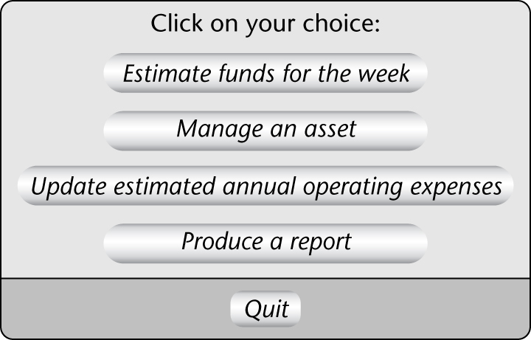
Initial Dynamic Model: MSG Foundation (contd)
An MSG staff member selects an option by clicking on the menu
This graphical user interface (GUI) requires special software
Figure 12.23

Slide 63
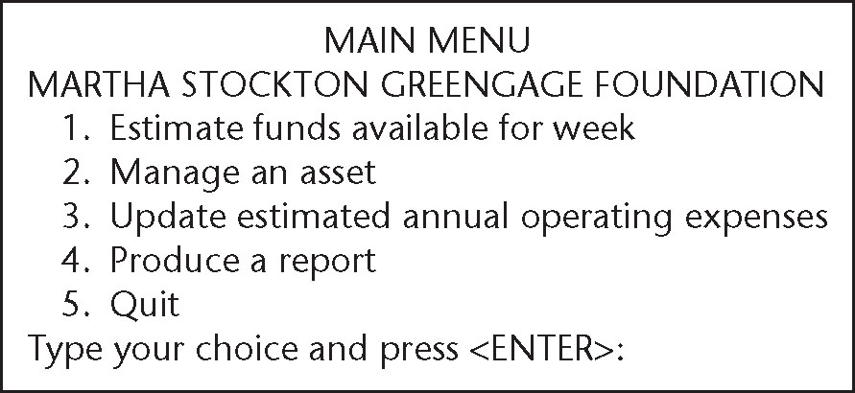
Initial Dynamic Model: MSG Foundation (contd)
Equivalent textual user interface that can run on any computer
Figure 12.24

Slide 64
12.12 Revising the Entity Classes: MSG Foundation
The initial functional model, the initial class diagram, and the initial dynamic model are completed
  Checking them reveals a fault
In the initial statechart, consider state Update Estimated Annual Operating Expenses with operation Update the estimated annual operating expenses
  This operation has to be performed on the current value of the estimated annual operating expense

Slide 65
Revising the Entity Classes: MSG Foundation (contd)
But where is the value of the estimated annual operating expenses to be found?
Currently there is only one class (Asset Class) and its two subclasses
  Neither is appropriate for storing the estimated annual operating expenses

Slide 66
Revising the Entity Classes: MSG Foundation (contd)
The only way a value can be stored on a long-term basis is as an attribute of an instance of that class or its subclasses
Another entity class is needed for storing the estimated annual operating expenses
  MSG Application Class

Slide 67
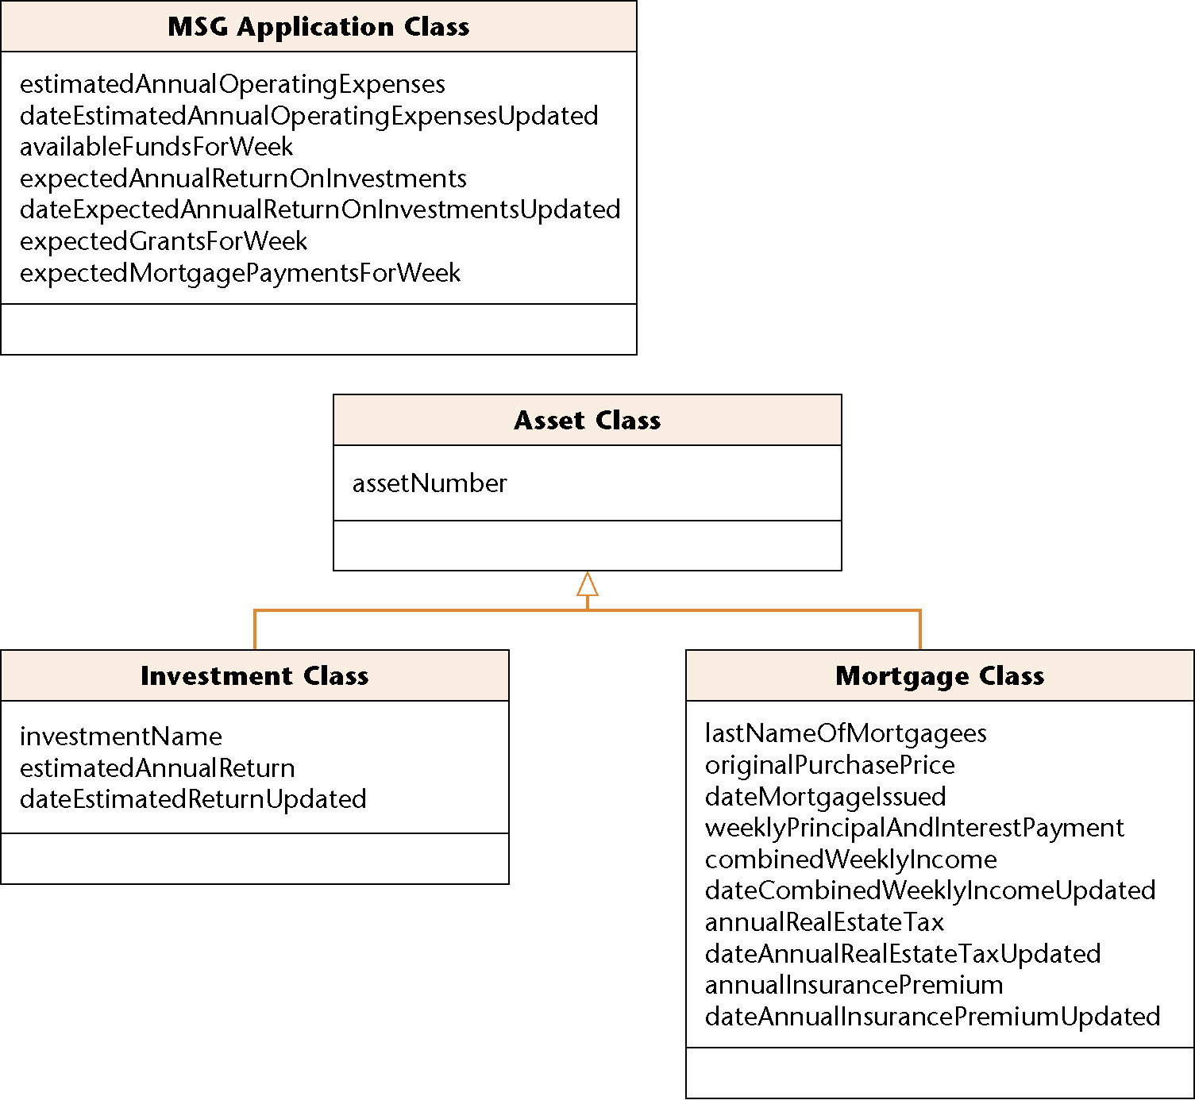
Third Iteration of the Initial Class Diagram: MSG Foundation
MSG Application Class has other attributes as well
  Attributes that do not appertain to the assets
Figure 12.25

Slide 68
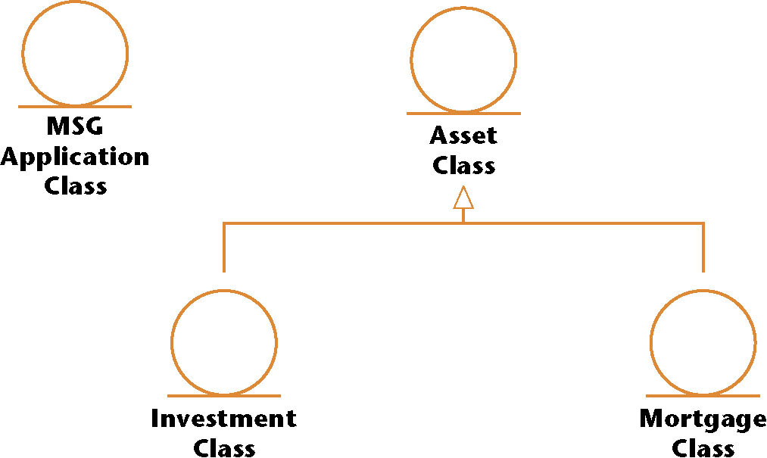
Third Iteration of the Initial Class Diagram: MSG Foundation
The class diagram redrawn to show the prototypes
Figure 12.26

Slide 69
12.13 Extracting the Boundary Classes: MSG Foundation
It is usually easy to extract boundary classes
  Each input screen, output screen, and printed report is generally modeled by a boundary class
One screen should be adequate for all four MSG Foundation use cases
    Estimate Funds Available for Week
    Manage an Asset
    Update Estimated Annual Operating Expenses
    Produce a Report
Accordingly there is one initial boundary class
  User Interface Class

Slide 70
Extracting Boundary Classes: MSG Foundation (contd)
Three reports have to be printed
  The estimated funds for the week report
  The listing of all mortgages
  The listing of all investments
Each of these has to be modeled by a separate boundary class
  Estimated Funds Report Class
  Mortgages Report Class
  Investments Report Class

Slide 71
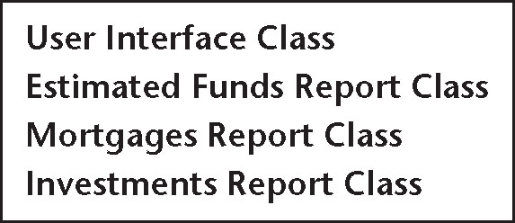
Extracting Boundary Classes: MSG (contd)
Here are the four initial boundary classes
Figure 12.27

Slide 72
Initial Boundary Classes: MSG Foundation (contd)
There are three reports:
  The purchases report
  The sales report
  The future trends report
The content of each report is different
  Each report therefore has to be modeled by a separate boundary class

Slide 73

12.14 Extracting the Control Classes: MSG Foundation
Each computation is usually modeled by a control class
The MSG Foundation case study has just one
  Estimate the funds available for the week
There is one initial control class
Figure 12.28

Slide 74
Class Extraction (contd)
The description of class extraction is complete
We now therefore return to the Unified Process

Slide 75
12.15 Use-Case Realization: The MSG Foundation Case Study
The process of extending and refining use cases is called use-case realization

Slide 76
Use-Case Realization (contd)
The verb “realize” is used at least 3 different ways:
  Understand (“Harvey slowly began to realize that he was in the wrong classroom”);
  Receive (“Ingrid will realize a profit of $45,000 on the stock transaction”); and
  Accomplish (“Janet hopes to realize her dream of starting a computer company”)
In the phrase “realize a use case,” the word “realize” is used in this last sense

Slide 77
Use-Case Realization (contd)
The realization of a specific scenario of a use case is depicted using an interaction diagram
  Either a sequence diagram or collaboration diagram
Consider use case Estimate Funds Available for Week
We have previously seen
  The use case
  The description of the use case

Slide 78
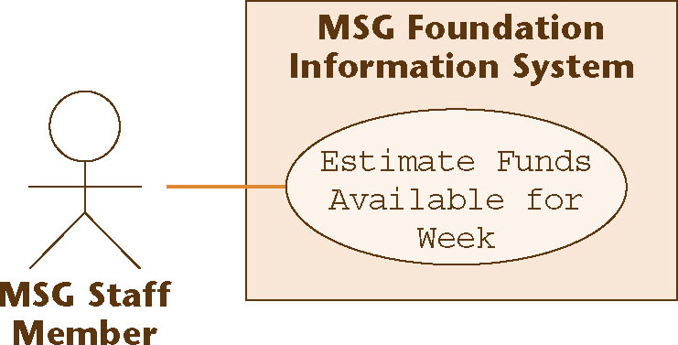
12.15.1 Estimate Funds Available for Week Use Case
Use-case diagram
Figure 12.29

Slide 79
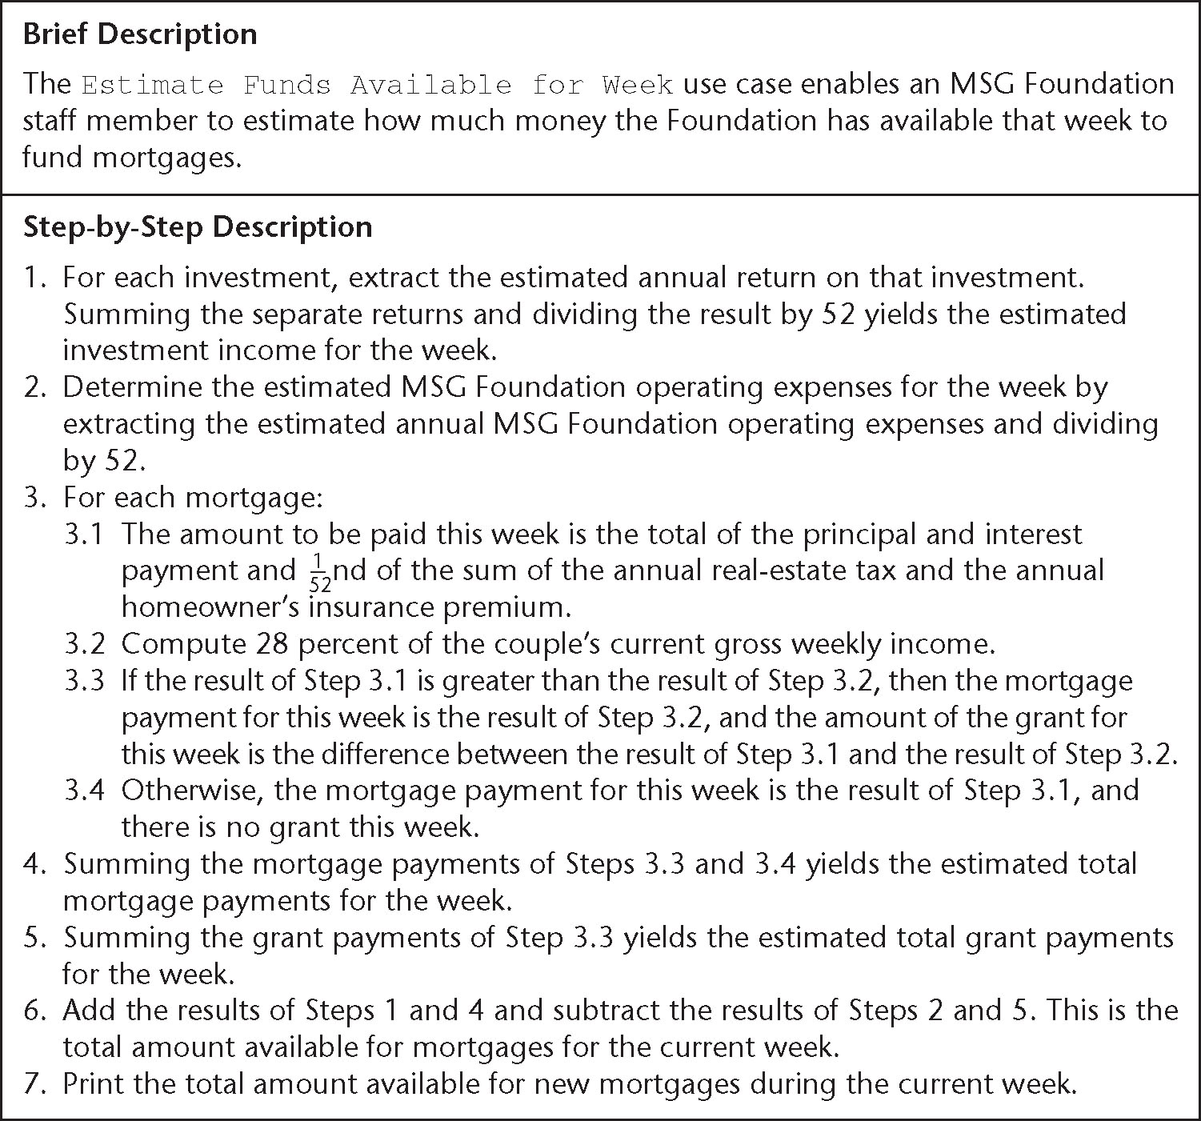
Estimate Funds Available for Week Use Case (contd)
Description of use case
Figure 12.30

Slide 80
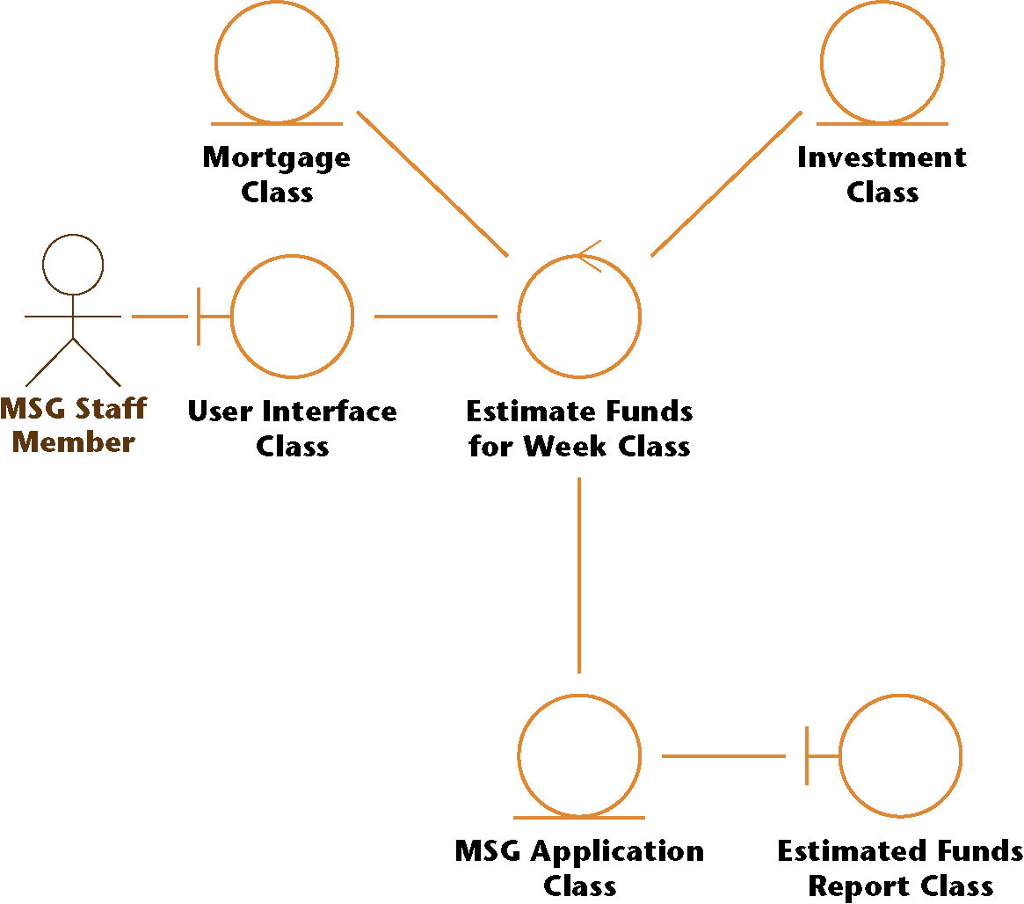
Estimate Funds Available for Week Use Case (contd)
Class diagram (classes that enter into the use case)
Figure 12.31

Slide 81
Estimate Funds Available for Week Use Case (contd)
The six classes that enter into this use case are:
  User Interface Class
    This class models the user interface
  Estimate Funds for Week Class
    This control class models the computation of the estimate of the funds that are available to fund mortgages during that week
  Mortgage Class
    This class models the estimated grants and payments for the week
  Investment Class
    This class models the estimated return on investments for the week
  MSG Application Class
    This class models the estimated return on investments for the week
  Estimated Funds Report Class
    This class models the printing of the report

Slide 82
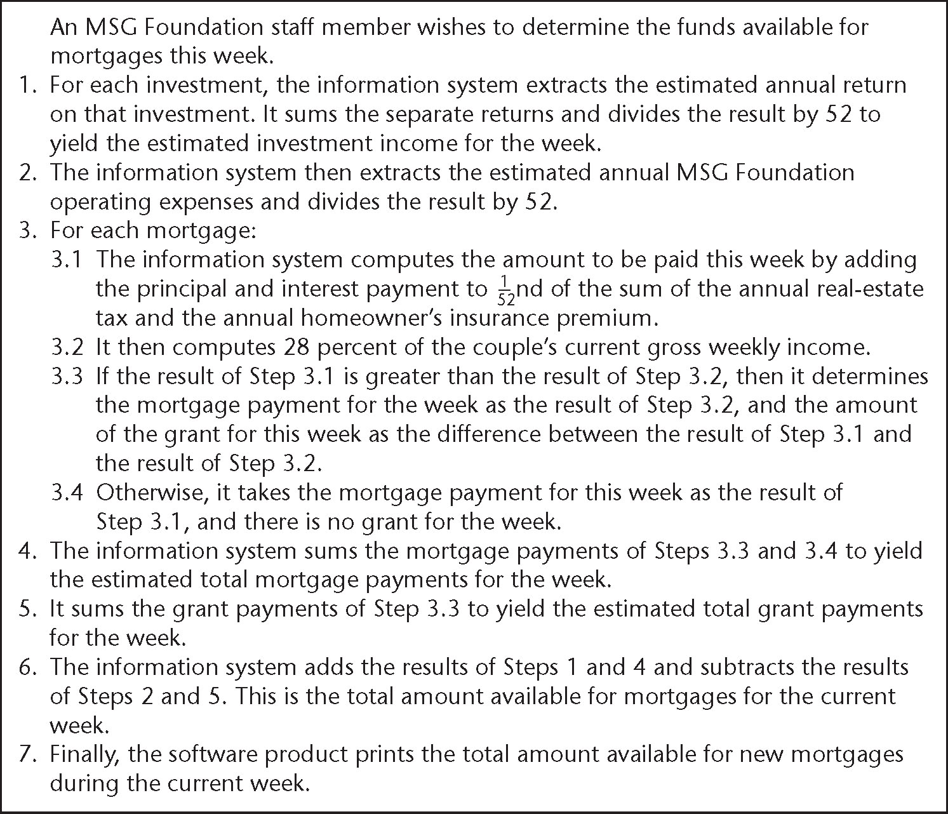
Estimate Funds Available for Week Use Case (contd)
Scenario (one possible instance of the use case)
Figure 12.32

Slide 83
Estimate Funds Available for Week Use Case (contd)
A working information system uses objects, not classes
  Example: A specific mortgage cannot be represented by Mortgage Class but rather by an object, a specific instance of Mortgage Class
Such an object is denoted by : Mortgage Class

Slide 84
Estimate Funds Available for Week Use Case (contd)
A class diagram shows the classes in the use case and their relationships
  It does not show the objects nor the sequence of messages as they are sent from object to object
Something more is needed

Slide 85
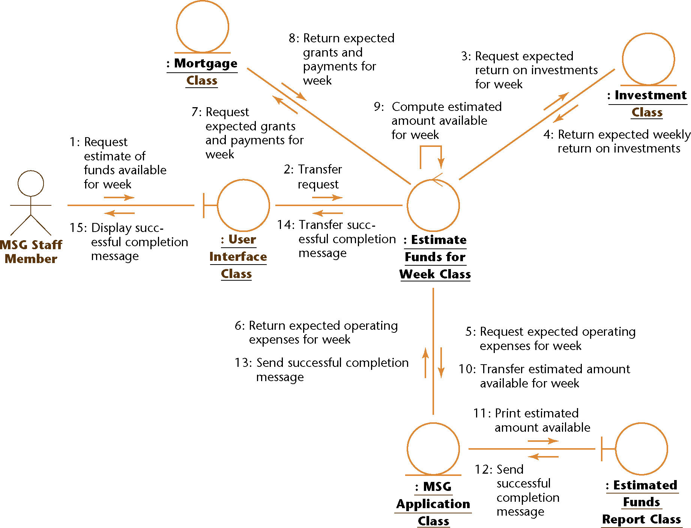
Estimate Funds Available for Week Use Case (contd)
Collaboration diagram (of the realization of the scenario of the use case)
Figure 12.33

Slide 86
Estimate Funds Available for Week Use Case (contd)
The collaboration diagram shows the objects as well as the messages, numbered in the order in which they are sent in the specific scenario

Slide 87
Estimate Funds Available for Week Use Case (contd)
Item 1:
  The staff member wants to compute the funds available for the week
  In the collaboration diagram, this is modeled by message
    1: Request estimate of funds available for week
  from MSG Staff Member to : User Interface Class, an instance of User Interface Class

Slide 88
Estimate Funds Available for Week Use Case (contd)
Item 2
  This request is passed on to : Estimate Funds for Week Class, an instance of the control class that actually performs the calculation
  This is modeled by message
    2: Transfer request
Four separate financial estimates are now determined by : Estimate Funds for Week Class

Slide 89
Estimate Funds Available for Week Use Case (contd)
Item 3
  In Step 1 of the scenario, the estimated annual return on investments is summed for each investment and the result divided by 52
  This extraction of the estimated weekly return is modeled by message
    3: Request estimated return on investments for week
  from : Estimate Funds for Week Class to : Investment Class followed by message
    4: Return estimated weekly return on investments
  in the other direction

Slide 90
Estimate Funds Available for Week Use Case (contd)
Item 4
  In Step 2 of the scenario, the weekly operating expenses are estimated by taking the estimated annual operating expenses and dividing by 52
  This extraction of the weekly expenses is modeled by message
    5: Request estimated operating expenses for week
  from : Estimate Funds for Week Class to : MSG Application Class followed by message
    6: Return estimated operating expenses for week
  in the other direction

Slide 91
Estimate Funds Available for Week Use Case (contd)
Item 5
  In Steps 3, 4, and 5 of the scenario, two estimates are determined
    the estimated grants for the week, and
    the estimated payments for the week
  This is modeled by message
    7: Request estimated grants and payments for week
  from : Estimate Funds for Week Class to : Mortgage Class, and by message
    8: Return estimated grants and payments for week
  in the other direction

Slide 92
Estimate Funds Available for Week Use Case (contd)
Item 6
  Now the arithmetic computation of Step 6 of the scenario is performed
  This is modeled by message
    9: Compute estimated amount available for week
  This is a self call
  : Estimate Funds for Week Class tells itself to perform the calculation
  The result of the computation is stored in : MSG Application Class by message
    10: Transfer estimated amount available for week

Slide 93
Estimate Funds Available for Week Use Case (contd)
Item 7
  The result is printed in Step 7 of the scenario
  This is modeled by message
    11: Print estimated amount available
  from : MSG Application Class to : Estimated Funds Report Class

Slide 94
Estimate Funds Available for Week Use Case (contd)
Item 8
  Finally, an acknowledgment is sent to the MSG staff member that the task has been successfully completed
  This is modeled by messages
    12: Send successful completion message
    13: Send successful completion message
    14: Transfer successful completion message, and
    15: Display successful completion message

Slide 95
Estimate Funds Available for Week Use Case (contd)
No client will approve the specification document without understanding it
Accordingly, a written description of the collaboration diagram is needed, the flow of events

Slide 96
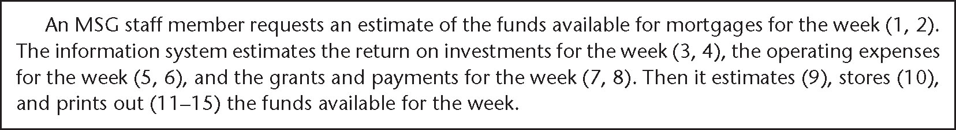
Estimate Funds Available for Week Use Case (contd)
The flow of events of the collaboration diagram of the realization of the scenario of the use case
Figure 12.34

Slide 97
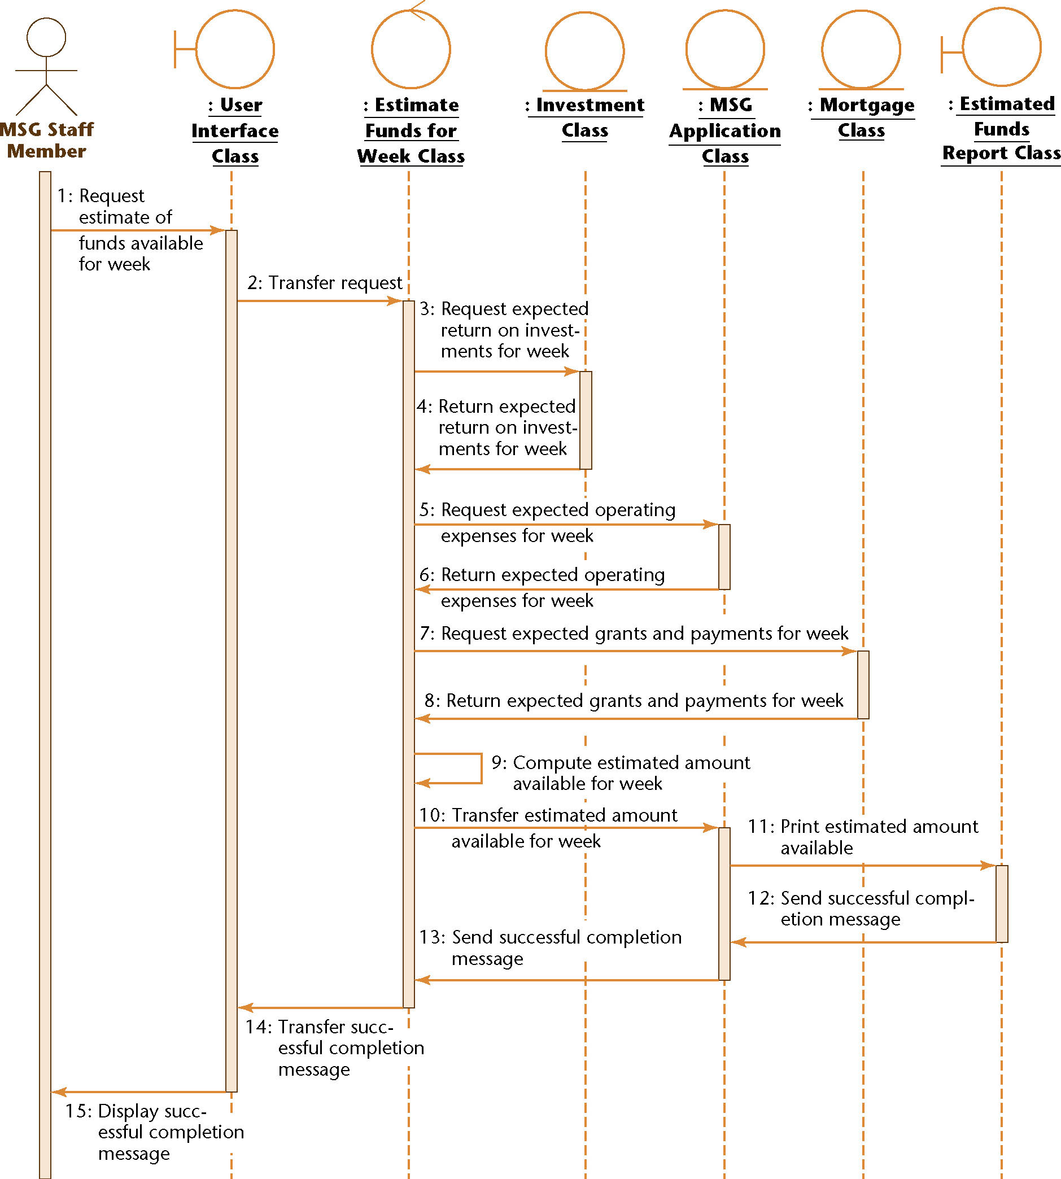
Estimate Funds Available for Week Use Case (contd)
Sequence diagram equivalent to the collaboration diagram (of the realization of the scenario of the use case)
Figure 12.35

Slide 98
Interaction Diagrams
The strength of a sequence diagram is that it shows the flow of messages and their order unambiguously
  When transfer of information is the focus of attention, a sequence diagram is superior to a collaboration diagram
A collaboration diagram is similar to a class diagram
  When the developers are concentrating on the classes, a collaboration diagram is more useful than the equivalent sequence diagram

Slide 99
Estimate Funds Available for Week Use Case (contd)
Figures 12.29 through 12.35 do not depict a random collection of UML artifacts
Instead, these figures depict a use case and artifacts derived from that use case
In more detail (see next slide):

Slide 100
Estimate Funds Available for Week Use Case (contd)
Figure 12.29 depicts the use case Estimate Funds Available for Week
The figure models
  All possible sets of interactions
  Between the actor MSG Staff Member (external to the software product) and the MSG Foundation software product itself
  That relate to the action of estimating funds available for the week

Slide 101
Estimate Funds Available for Week Use Case (contd)
Figure 12.30 is the description of that use case
The figure provides a written account of the details of the Estimate Funds Available for Week use case of Figure 12.29

Slide 102
Estimate Funds Available for Week Use Case (contd)
Figure 12.31 is a class diagram showing the classes that realize the Estimate Funds Available for Week use case
The figure depicts
  The classes that are needed to model all possible scenarios of the use case
  Together with their interactions

Slide 103
Estimate Funds Available for Week Use Case (contd)
Figure 12.32 is a scenario
It depicts one specific instance of the use case of Figure 12.29

Slide 104
Estimate Funds Available for Week Use Case (contd)
Figure 12.33 is a collaboration diagram of the realization of the scenario of Figure 12.32
The figure depicts the objects and the messages sent between them in the realization of that one specific scenario

Slide 105
Estimate Funds Available for Week Use Case (contd)
Figure 12.34 is the flow of events of the collaboration diagram of the realization of the scenario of Figure 12.32
Figure 12.34 is a written description of the realization of the scenario of Figure 12.32
  (Compare: Figure 12.30 is a written description of the Estimate Funds Available for Week use case of Figure 12.29)

Slide 106
Estimate Funds Available for Week Use Case (contd)
Figure 12.35 is the sequence diagram that is fully equivalent to the collaboration diagram of Figure 12.33
The sequence diagram depicts the objects and the messages sent between them in the realization of the scenario of Figure 12.32
Its flow of events is therefore also shown in Figure 12.34

Slide 107
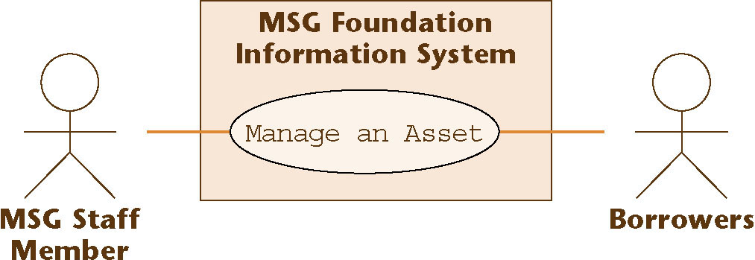
12.5.2 Manage an Asset Use Case
Use case
Figure 12.36

Slide 108
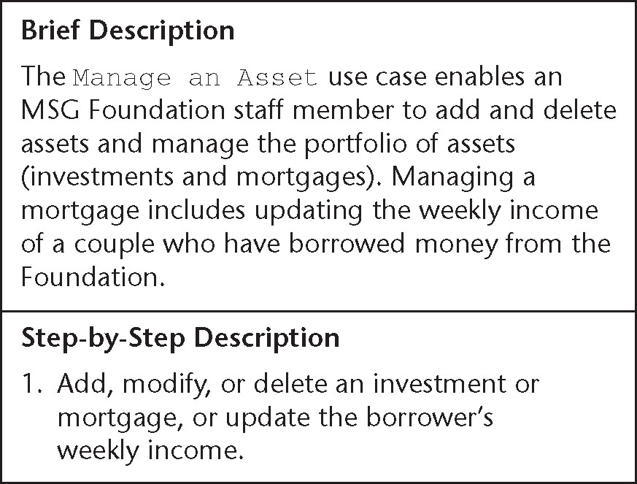
Manage an Asset Use Case (contd)
Description of use case
Figure 12.37

Slide 109
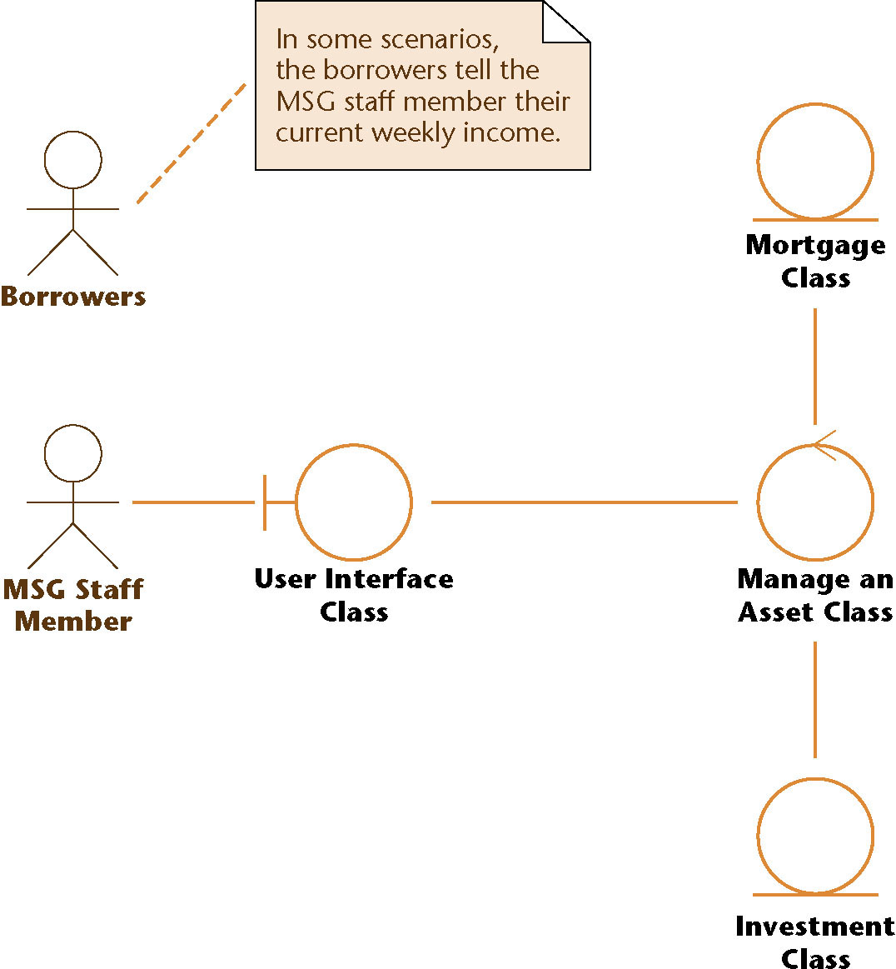
Manage an Asset Use Case (contd)
Class diagram showing the classes that realize the use case
Figure 12.38

Slide 110
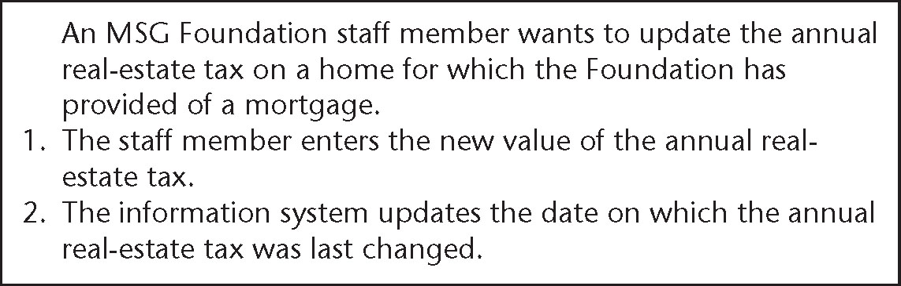
Manage an Asset Use Case (contd)
One scenario of the use case
Figure 12.39

Slide 111
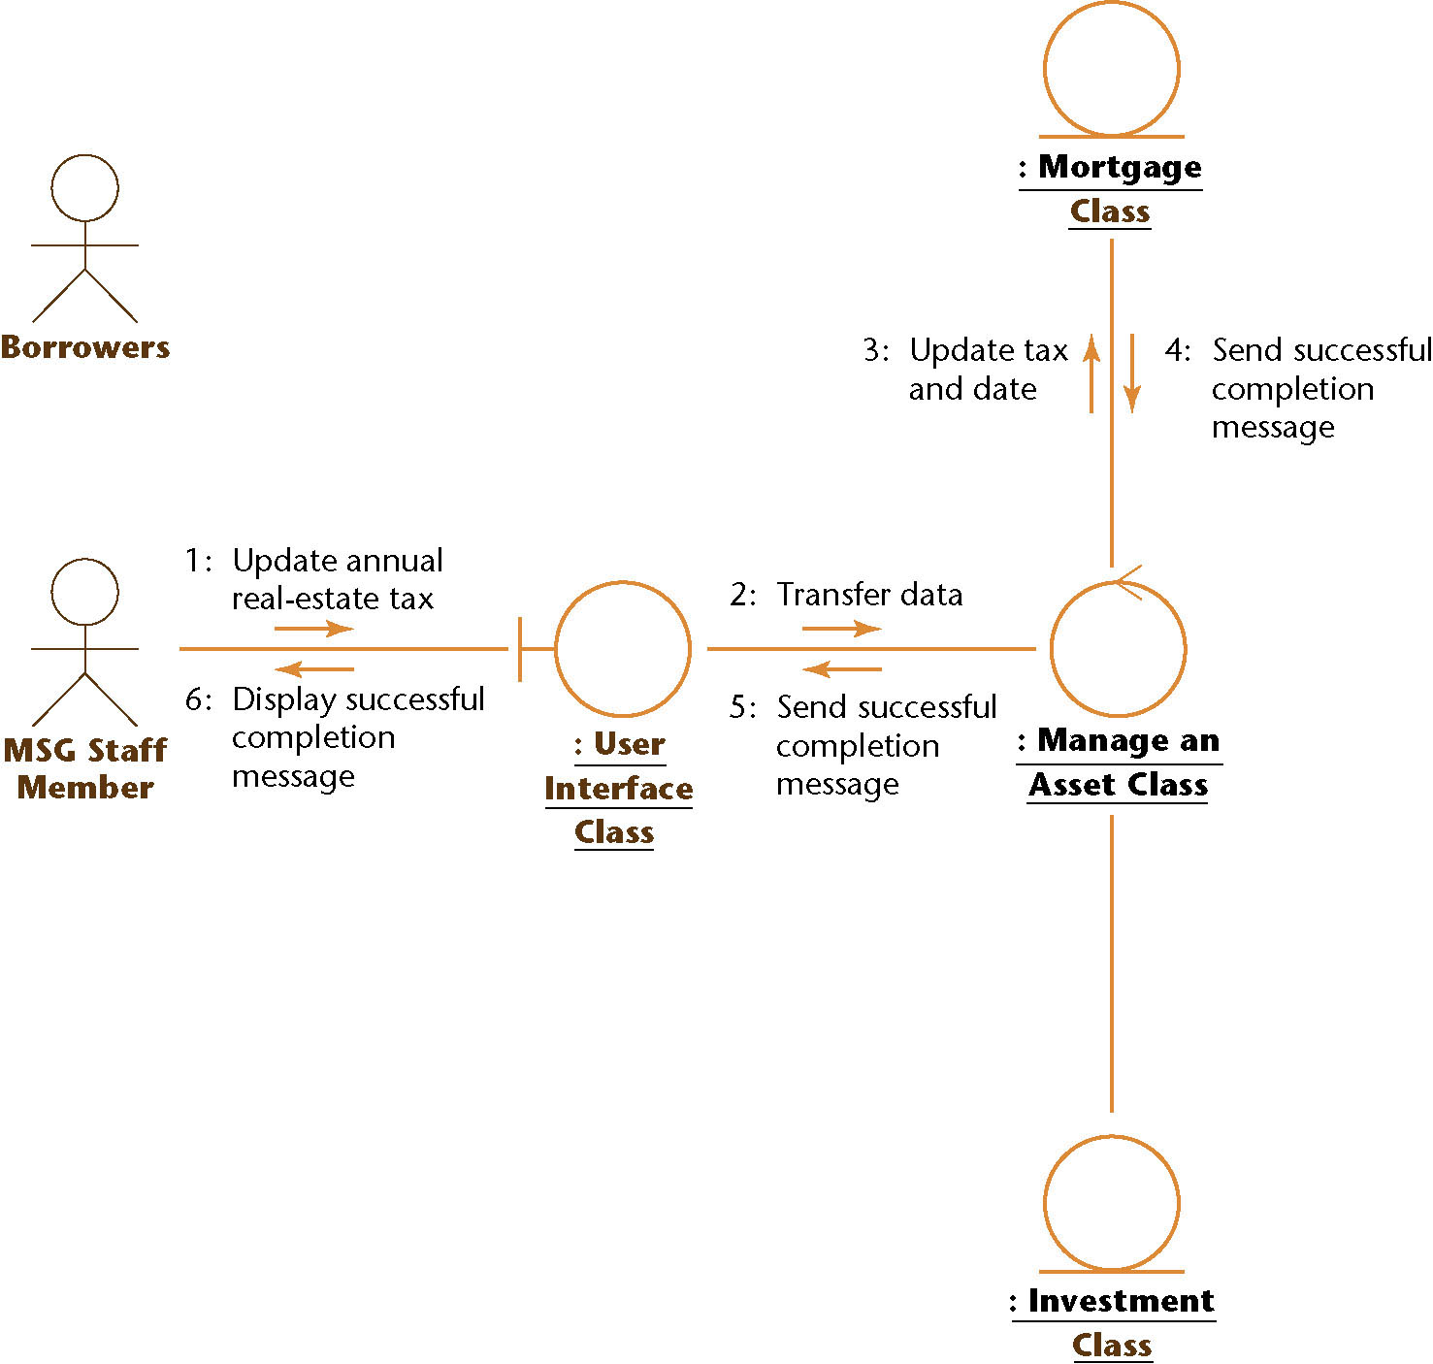
Manage an Asset Use Case (contd)
Collaboration diagram of the realization of the scenario of the use case
Figure 12.40

Slide 112
Manage an Asset Use Case (contd)
Object : Investment Class does not play an active role in this collaboration diagram
  This scenario does not involve an investment, only a mortgage
Actor Borrowers does not play a role in this use case, either

Slide 113
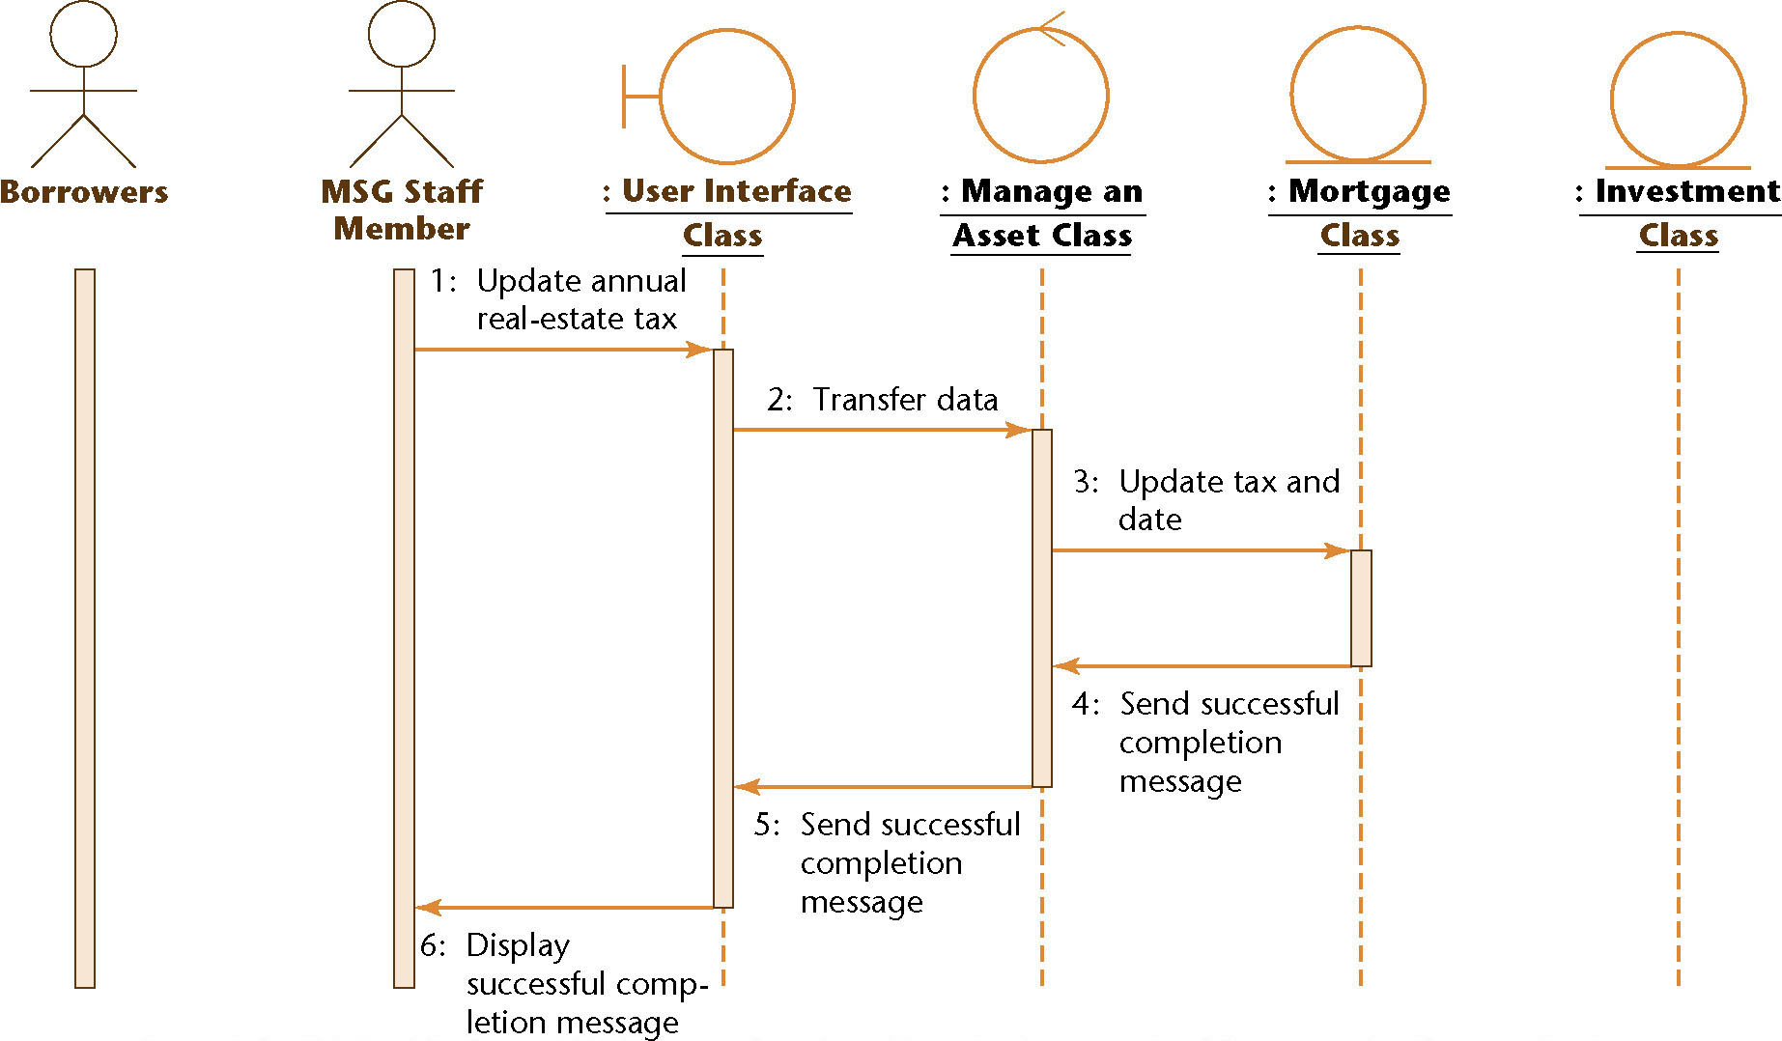
Manage an Asset Use Case (contd)
Sequence diagram equivalent to the collaboration diagram (of the realization of the scenario of the use case)
Figure 12.41

Slide 114
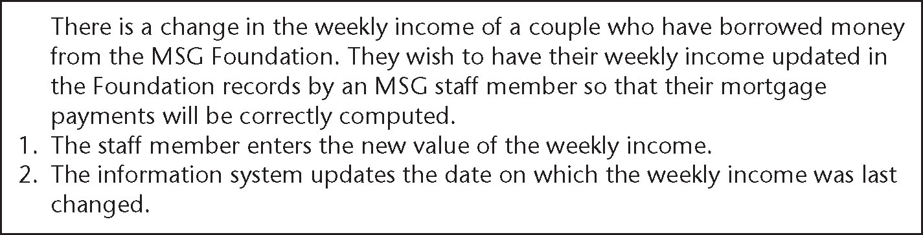
Manage an Asset Use Case (contd)
A different scenario of the use case
Figure 12.42

Slide 115
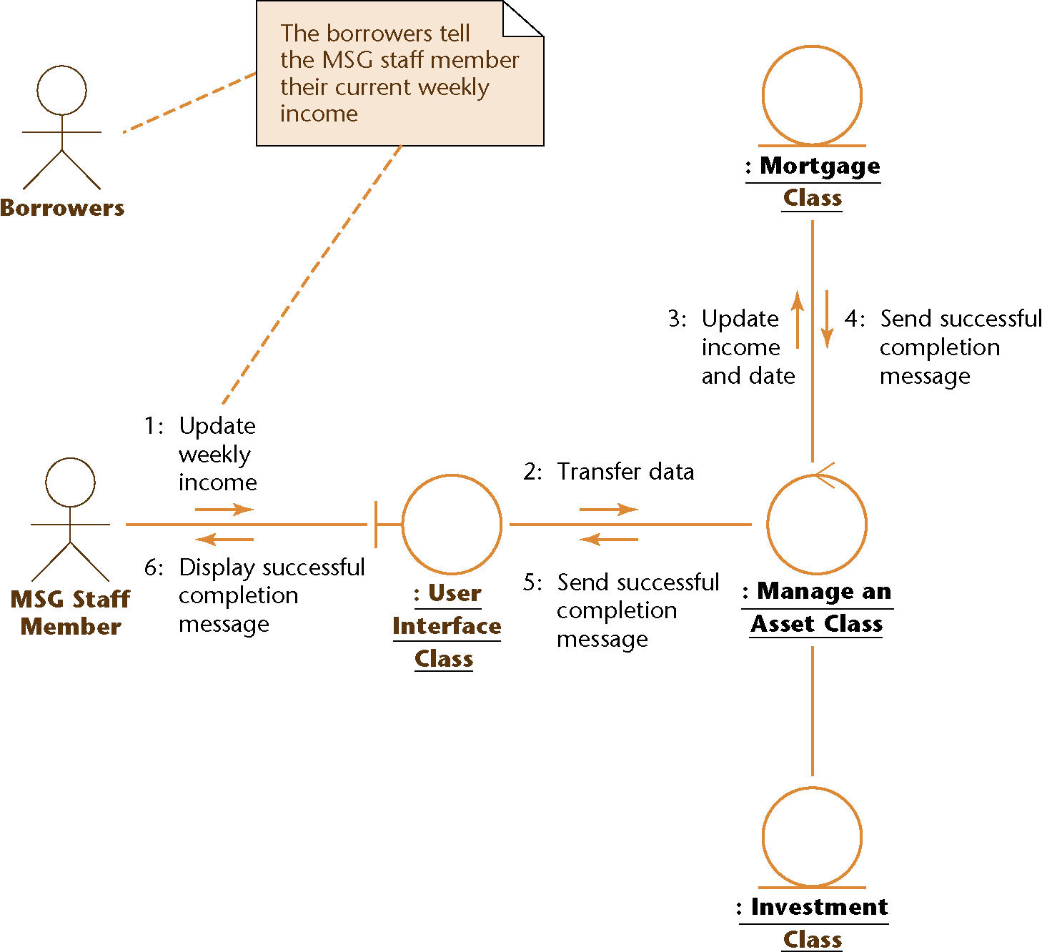
Manage an Asset Use Case (contd)
Collaboration diagram of the realization of the scenario of the use case
Figure 12.43

Slide 116
Manage an Asset Use Case (contd)
At the request of the borrowers, the MSG staff member updates the weekly income of a couple
The scenario is initiated by the Borrowers
Their data are entered into the software product by the MSG Staff Member
  This is stated in the note in the collaboration diagram

Slide 117
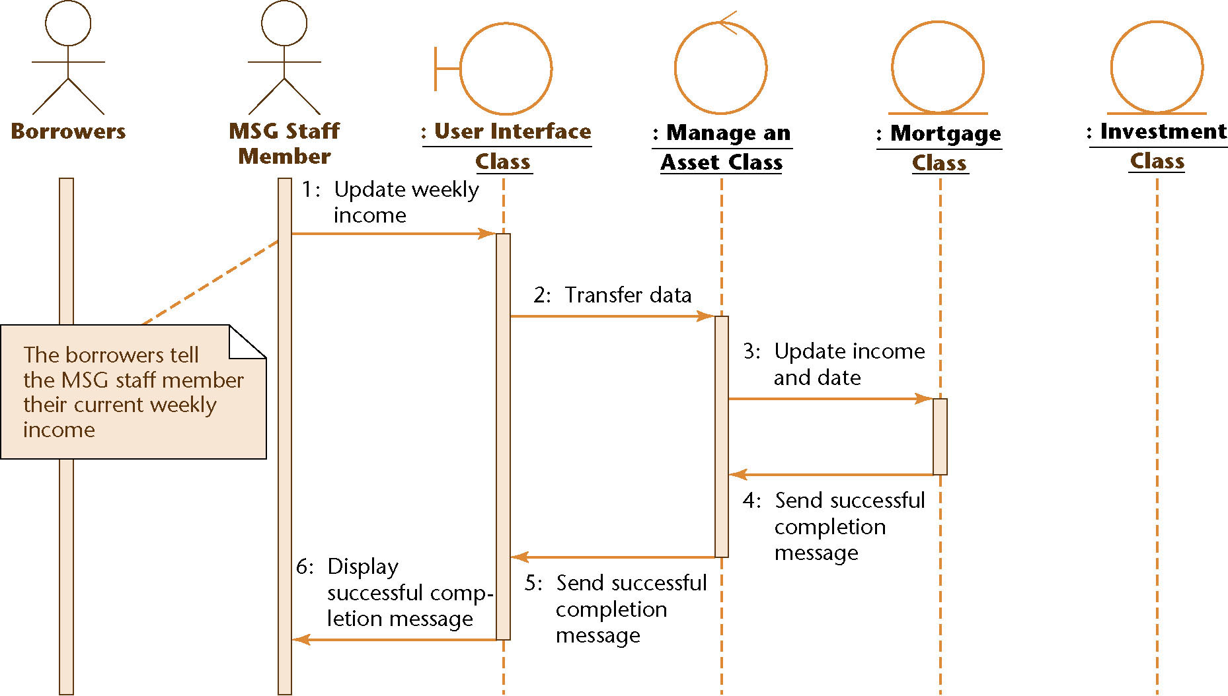
Manage an Asset Use Case (contd)
Sequence diagram equivalent to the collaboration diagram (of the realization of the scenario of the use case)
Figure 12.44

Slide 118
Manage an Asset Use Case (contd)
Two different scenarios of the same use case have been presented
The use case is the same
  The class diagram is therefore the same
However, the collaboration (and sequence) diagrams reflect the differences between the two scenarios

Slide 119
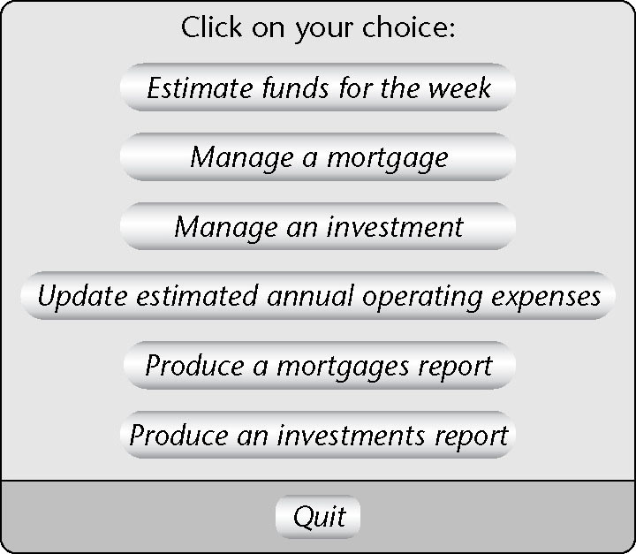
Manage an Asset Use Case (contd)
Boundary class User Interface Class appears in all the realizations
  The same screen will be used for all commands of the information system
Revised menu
Figure 12.45

Slide 120
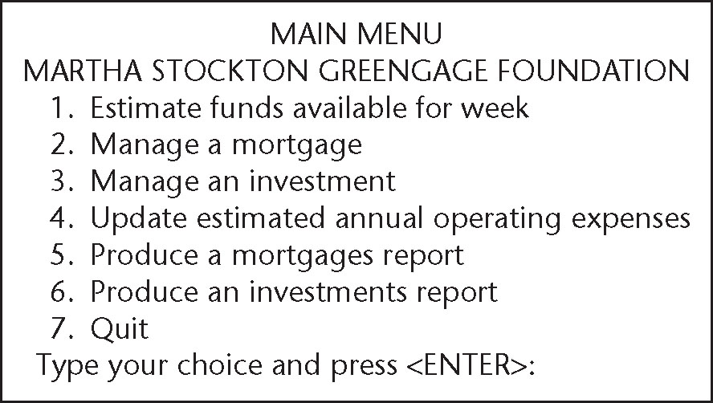
Manage an Asset Use Case (contd)
Corresponding textual interface
Figure 12.46

Slide 121

Update Annual Operating Expenses Use Case
Class diagram
Figure 12.47

Slide 122
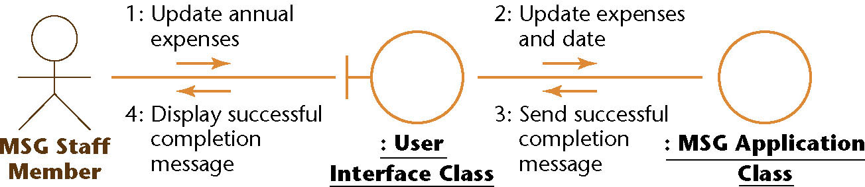
Update Annual Operating Expenses Use Case (contd)
Collaboration diagram of a realization of a scenario of the use case
Figure 12.48

Slide 123
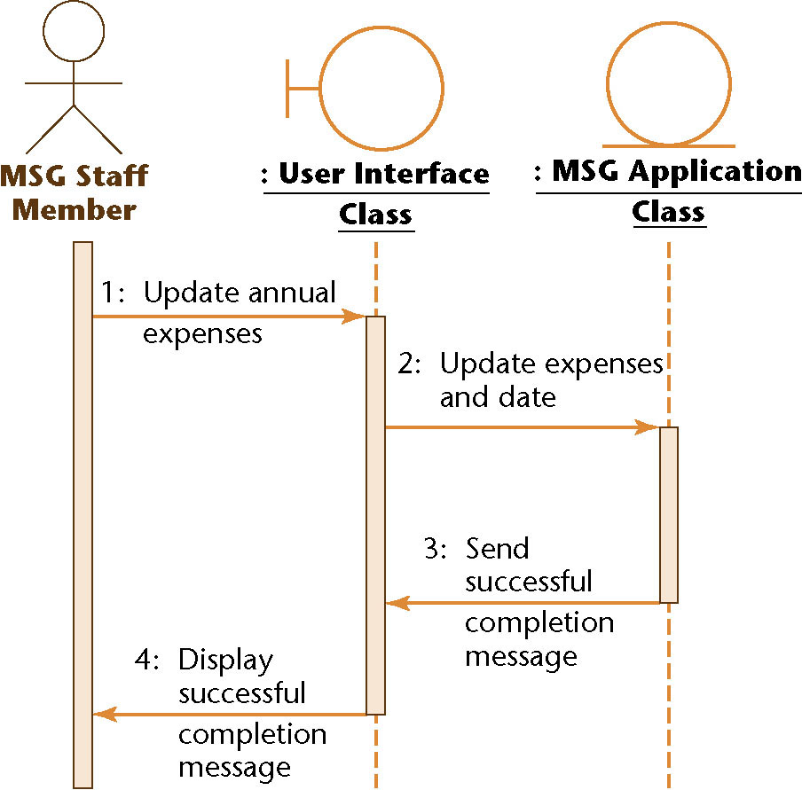
Update Annual Operating Expenses Use Case (contd)
Equivalent sequence diagram
Figure 12.49

Slide 124
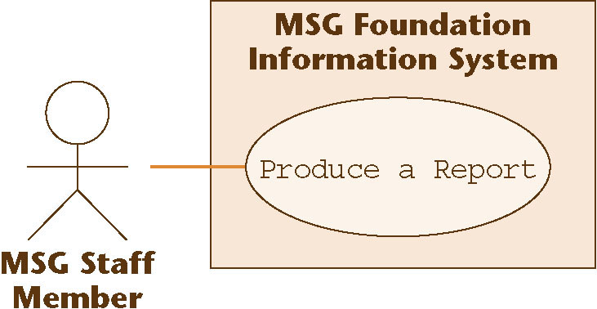
12.15.4 Produce a Report Use Case
Use case
Figure 12.50

Slide 125
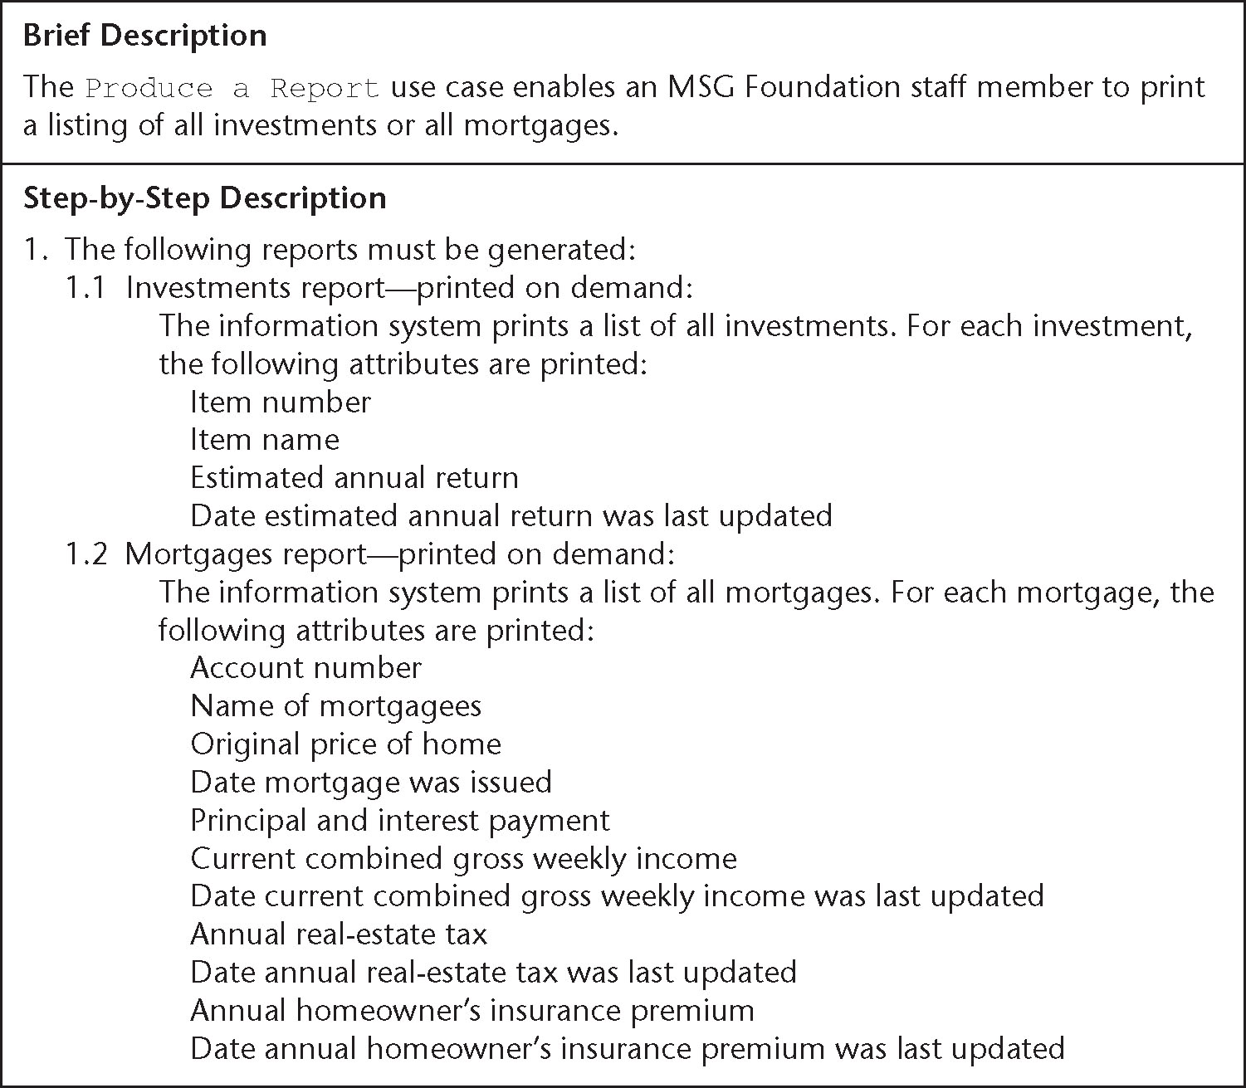
Produce a Report Use Case (contd)
Description of use case
Figure 12.51

Slide 126
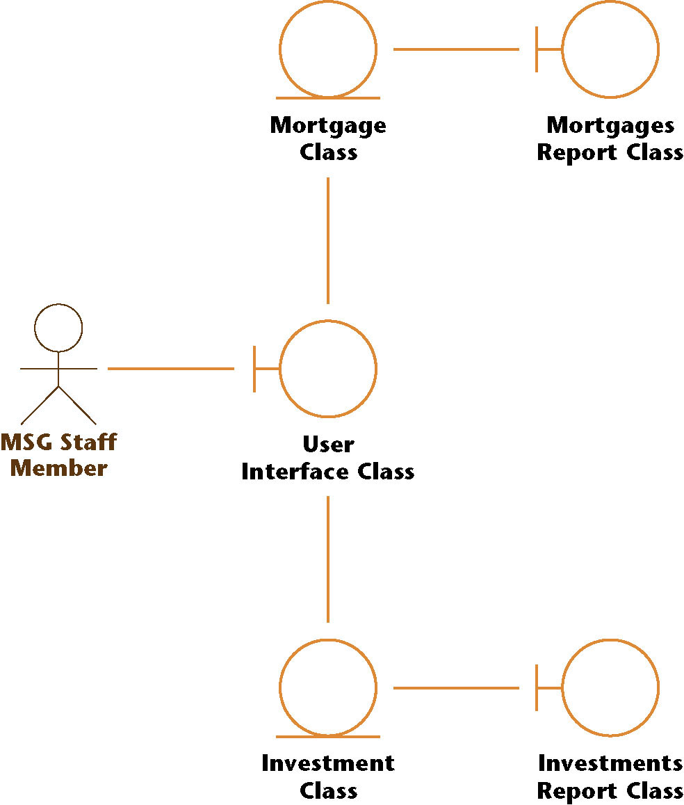
Produce a Report Use Case (contd)
Class diagram
Figure 12.52

Slide 127

Produce a Report Use Case (contd)
One scenario of the use case
Figure 12.53

Slide 128
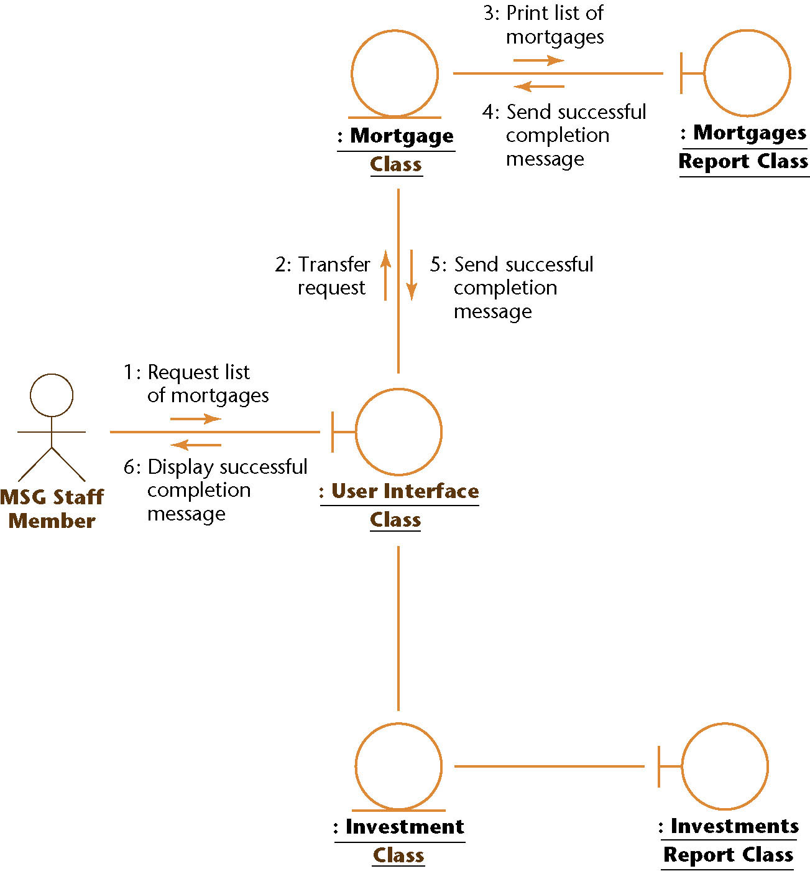
Produce a Report Use Case (contd)
Collaboration diagram
  Mortgages (but not investments) are involved
Figure 12.54

Slide 129
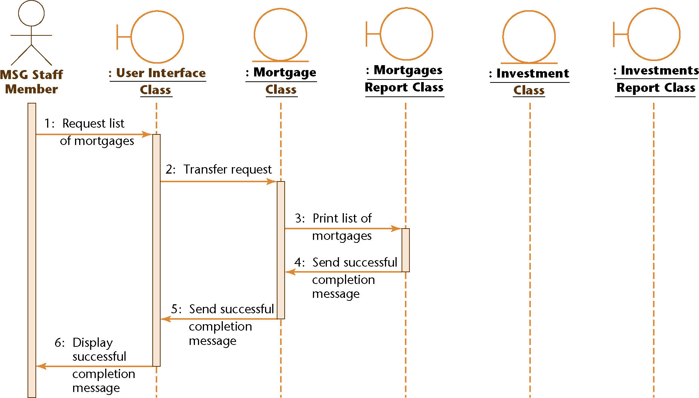
Produce a Report Use Case (contd)
Sequence diagram
Figure 12.55

Slide 130

Produce a Report Use Case (contd)
A second scenario (listing all investments) of the use case
Figure 12.56

Slide 131

Produce a Report Use Case (contd)
Collaboration diagram for second scenario
  This time, investments (but not mortgages) are involved
Figure 12.57

Slide 132

Produce a Report Use Case (contd)
Sequence diagram for second scenario
Figure 12.58

Slide 133
12.16 Incrementing the Class Diagram: The MSG Foundation
In the course of realizing the various use cases
  Interrelationships between classes become apparent
Accordingly, we now combine the realization class diagrams

Slide 134

Combining the Realization Class Diagrams
Figure 12.59

Slide 135

Fourth Iteration of the Class Diagram
Fifth iteration + realization class diagram
Figure 12.60

Slide 136
Software Project Management Plan
As with the classical paradigm, the SPMP is drawn up at this point
  It appears in Appendix F
  The plan conforms to the IEEE SPMP format

Slide 137
12.17 The Test Workflow: MSG Foundation
CRC cards are used to check the entity classes
All the artifacts are then inspected

Slide 138
12.18 The Specification Document in the Unified Process
The Unified Process is use-case driven
  The use cases and the artifacts derived from them replace the traditional textual specification document
The client must be shown each use case and associated artifacts, both diagrammatic and textual
  These UML diagrams convey to the client more information more accurately than the traditional specification document
  The set of UML diagrams can also play the same contractual role as the traditional specification document

Slide 139
The Specification Document (contd)
A scenario is a specific execution sequence
The client can therefore appreciate how the product works equally well from
  A use case together with its scenarios, or
  A rapid prototype
The difference is
  The use cases are successively refined, with more information added each time, whereas
  The rapid prototype is discarded

Slide 140
The Specification Document (contd)
However, a rapid prototype of the user interface is required
  Specimen screens and reports are needed (not a complete rapid prototype)

Slide 141
12.19 More on Actors and Use Cases
To find the actors, consider every role in which an individual can interact with the software product
  Example: Applicants, Borrowers
Actors are not individuals
  They are roles played by those individuals
Find all the different roles played by each user
  From the list of roles, extract the actors

Slide 142
More on Actors and Use Cases (contd)
In the Unified Process
  The term worker is used to denote a role played by an individual
  In the Unified Process, Applicants and Borrowers are two different workers
In common parlance
  The word “worker” usually refers to an employee
In this book, the word “role” is used in place of “worker”

Slide 143
More on Actors and Use Cases (contd)
Within a business context, finding the roles is easy
  They are displayed within the use-case business model
To find the actors
  Find the subset of the use-case business model that corresponds to the use-case model of the requirements

Slide 144
More on Actors and Use Cases (contd)
To find the actors (in more detail):
  Construct the use-case business model
  Consider only those parts of the business model that correspond to the proposed software product
  The actors in this subset are the actors we seek

Slide 145
More on Actors and Use Cases (contd)
Within a business context, finding use cases is easy
For each role, there will be one or more use cases
  Find the actors (see previous slide)
  The use cases then follow

Slide 146
12.20 CASE Tools for the Object-Oriented Analysis Workflow
Diagrams play a major role in object-oriented analysis
Diagrams often change
  We need a diagramming tool
  Many tools go further
All modern tools support UML
  Commercial examples
    IBM Rational Rose
    Together
  Open-source example
    ArgoUML

Slide 147
12.21 Challenges of the Object-Oriented Analysis Workflow
Do not cross the boundary into object-oriented design
Do not allocate methods to classes yet
  Reallocating methods to classes during stepwise refinement is wasted effort

